Slide 1
Elections
What is the easiest way for citizens to influence the government?

Slide 2
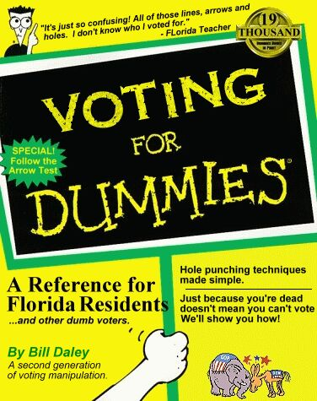
Who Can Vote?
In order to vote, you must be a US citizen, 18 years old, not in prison, and registered to vote.
Some convicted felons lose the right to vote forever. In NC, felons can vote when they have completed their sentences.
You can get registration materials many places including libraries, schools, and county election offices.
You can also register at the DMV when you renew your driver’s license.

Slide 3
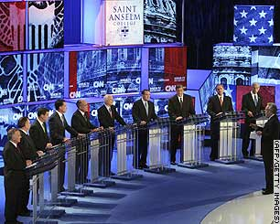
Voting Process
Candidates officially file forms to run for office well ahead of the election.
Primary Elections determine the official candidate of each party.
Candidates from the same party may take part in debates before the Primary.
Candidates from different parties take part in debates before the General Election.

Slide 4
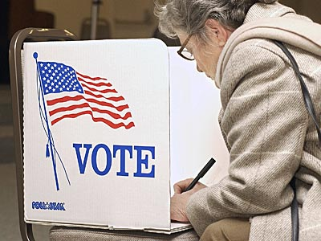
Voting Process
Each county is divided into pieces of equal population called precincts. Registered voters are assigned a precinct with a polling place based on where they live.
After proving their identities, voters complete their ballot by choosing one candidate for each open office.
Straight ticket: vote for the same party in each race.
Split ticket: vote for different parties on same ballot.

Slide 5
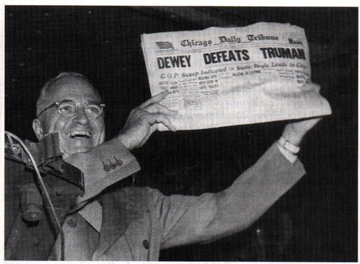
Process continued…
If unable to reach the polling place on election day, a voter can complete an absentee ballot and mail it in.
Winners of races are determined by counting all ballots, but many media outlets guess (called making a projection) on who has won a race based on a percentage of the votes.
This can sometimes cause people not to vote. Also, these projections can be wrong.

Slide 6
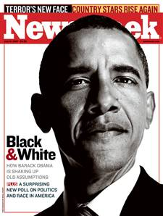
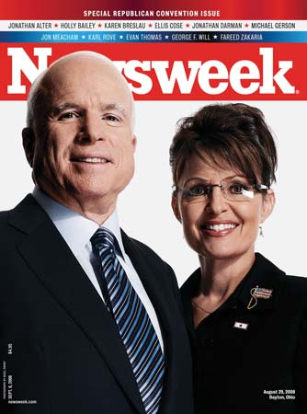
Who to Vote For?
Stay informed with TV, magazines, newspapers, and the Internet.
Questions to consider:
1. Does the candidate share your same views?
2. Is the candidate reliable?
3. Is the candidate experienced?
4. Will the candidate be effective?
5. Does the candidate have a chance to win?

Slide 7
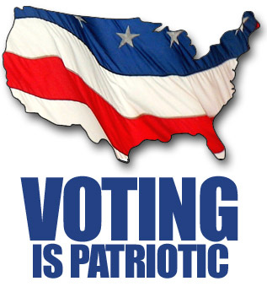
Types of Elections
General elections: decide people who will fill positions in government. Always takes place on the first Tuesday after the first Monday of November in even years.
- Who elected?: President every four years; all members of House and 1/3 of Senators every two years; several members of State and Local government.
Issue Elections: decide government issues other than who will take part. Can take place any time of year.
- Initiative: voters decide to support or reject a new law.
- Referendum: voters can decide to overturn an existing law.

