Slide 1
National, State, and Local Economy
Essential Questions: What are the major industries in the United States and the local economy? What steps can the government take to protect the local, state, and national economies?

Slide 2
United States’ Economy
World’s richest country the USA finished third in exporting last year. America shipped $1.48 trillion worth of goods around the globe, led by the top 10 items in the list below.
Major US Industries:

Slide 3
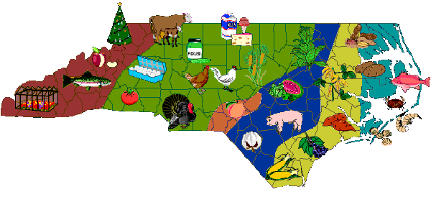
North Carolina Major Industries
Agriculture (Aquaculture)
Forestry
Industrial – manufacturing
Furniture
Textiles
Government Sector – specifically defense industry

Slide 4
State Economy - Agriculture
North Carolina is considered to be a high producer of tobacco, cotton, corn, soybeans, peanuts, and wheat.
Our agricultural industry along with food, fiber and forestry contributes $70 billion annually to the state’s economy.
It is also responsible for employing 17% of residents and 18% of the overall state income

Slide 5
State Economy - Industrial
North Carolina over the past 20 years has become home to some thriving industries.
Information and software technology, defense, automotive, financial services, green and sustainable energy, aerospace and aviation, biotechnology and pharmaceuticals.
NC is now considered to be more of a global economy than our previous traditional economy
GDP is the 9th highest in the U.S. at $424.9 billion
There are more bank headquarters are located in Charlotte than all but 1 other U.S. city

Slide 6
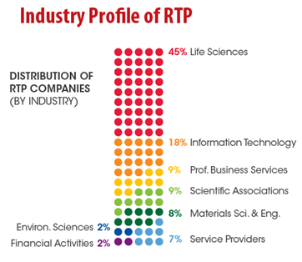
Local Economy: Wake County
Out of all 100 counties, Wake county ranks 47 in overall agricultural sales.
Corn, tobacco, wheat, and soybeans are some of the largest industries in Wake County
Aside from agriculture, Wake County is also home to RTP
RTP is a major industrial hub including industries such as Biotechnology and Life Sciences, Clean and Green Energy, Banking, Gaming, Information Technologies, and Wireless Communications.

Slide 7
Impact of Outsourcing
Outsourcing – when companies move jobs to other countries (or states) where labor is cheaper in order to reduce production costs.
Negatives for NC industries – As more NC industries outsource their jobs to countries with lower labor costs, our citizens lose their jobs and incomes. As individuals lose their incomes, the government loses out on collecting income taxes, therefore the overall NC economy suffers.
Positives for NC – (very few) – some states with higher costs of living/production have outsourced their manufacturing jobs to the South, and states like NC, because they can pay their workers lower fees
NC is a Right to Work State – so we do not have Unions which often drive up the wages/salaries for employees

