Slide 1
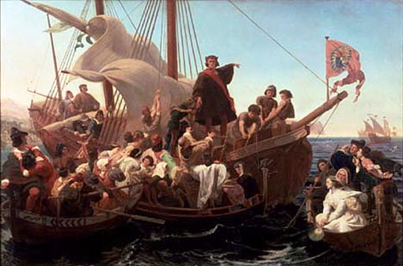
Motives for Exploration

Slide 2
KEY QUESTIONS! 1.) What motives exploration? 2.) Describe the differences between Spanish, French and English motives for exploration of the Americas. 3.) How did European exploration and settlement of the Americas affect Native Americans?

Slide 3
The Early Middle Ages
During the Crusades, Europeans were introduced to luxury goods from Asia.
** Goods were carried on a trade route through the Mongol Empire.
** Black plague and Mongol Empire disrupted trade.

Slide 4
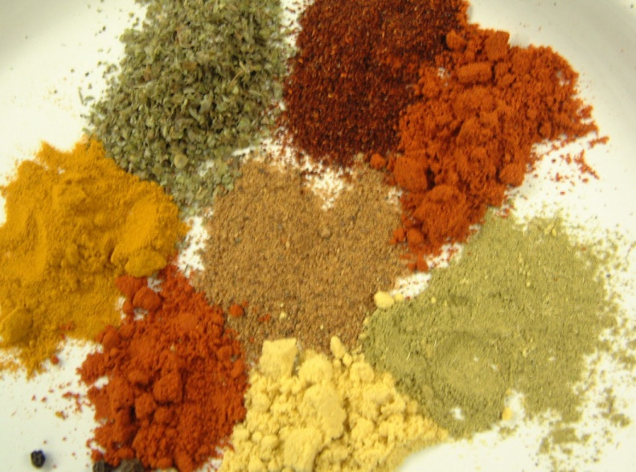
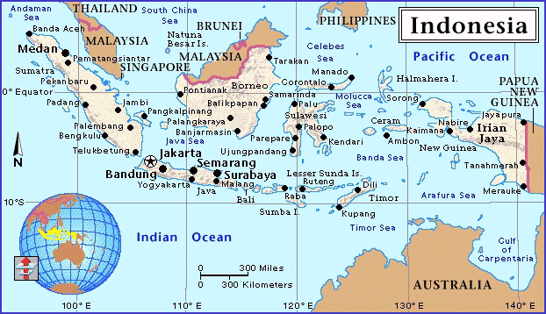
The Search for Spices
The most valuable items were Spices.
preserving food
flavoring food
Medicine
perfume
To kings & queens spices meant $$$
Europeans could trade with China
However Muslim and Italian merchants controlled these trade routes
So they had to find a new route to reach Asia.

Slide 5
What does this mean?
“But in truth, should I meet with gold or spices in great quantity, I shall remain till I collect as much as possible and for this purpose I am proceeding solely in quest of them”
Christopher Columbus 19 Oct 1492

Slide 6
What does this mean?
“to serve God and His Majesty, to give light to those who were in darkness and to grow rich, as all men desire to do”
Diaz del Castillo

Slide 7
What does this mean?
“I assure your Highness that these lands are the most fertile, temperate, level, and beautiful countries in the world”
Columbus

Slide 8
What does this mean?
“The cause by which the Christians have been driven to kill and destroy so many- such an infinite number of souls- has been simply to get the Indians’ gold.”
Bartolome de Las Casas

Slide 9
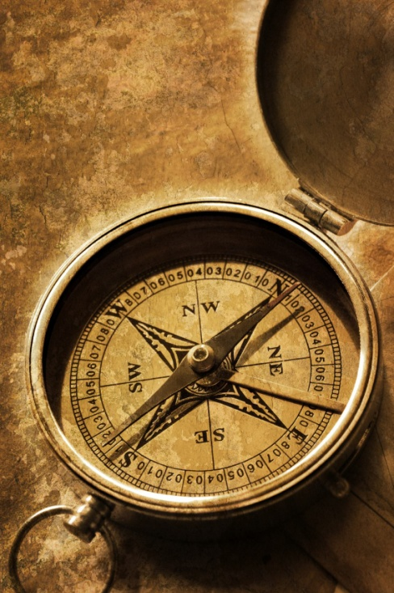
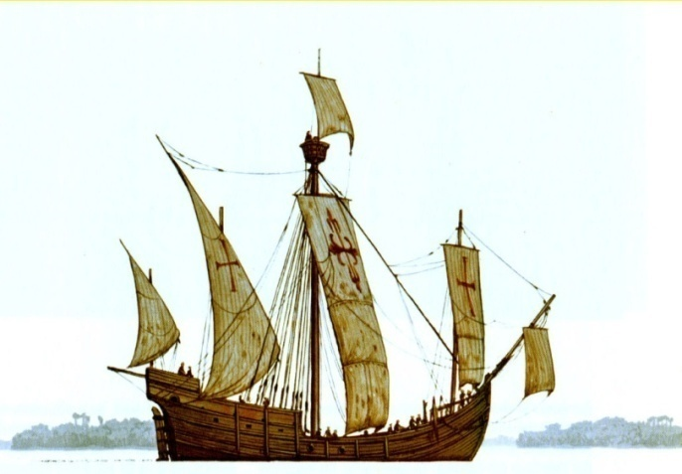
Motives for Exploration
Trade route to Asia
Silk and Spices
God, Glory, Gold
Improved technology
Cartographers = map makers
Astrolabes = used horizon to determine latitude and longitude
Compasses = determine location.
Caravel = stronger and faster ship.

Slide 10
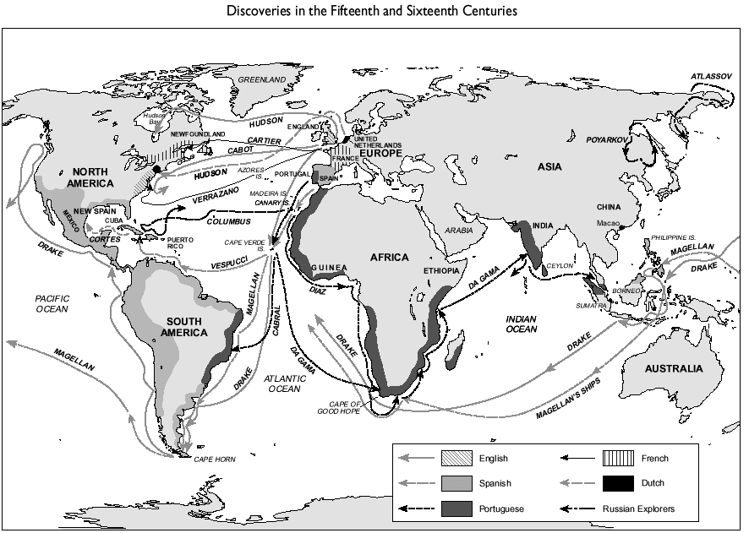
Motives for Exploration
Trade route to Asia
Silk and Spices
God, Glory, Gold
Improved technology
Cartographers = map makers
Astrolabes = used horizon to determine latitude and longitude
Compasses = determine location.
Caravel = stronger and faster ship.

Slide 11
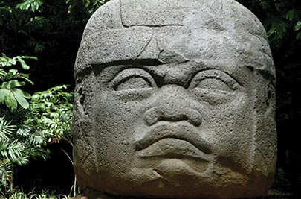
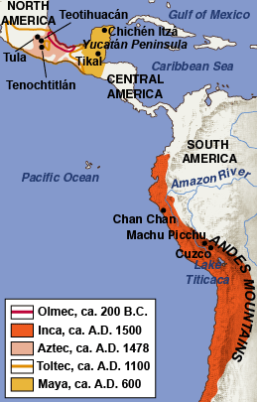
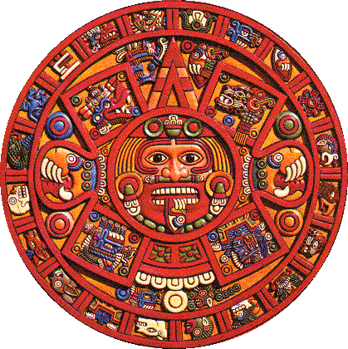
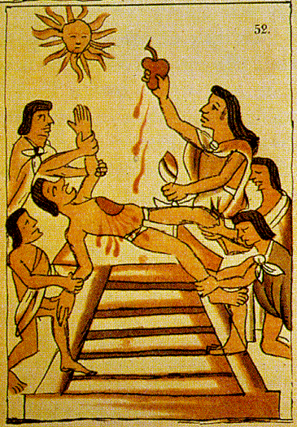
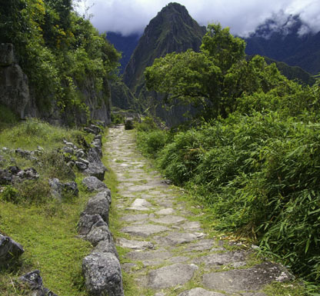
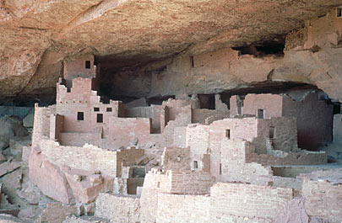
The First Americans
South American Civilizations
Olmec = mother civilization
Maya = Yucatan peninsula; calendar; human sacrifice
Aztec = Mexico City; human sacrifice
Inca = Andes Mountains; human sacrifice; silver and gold
North American Civilizations
Pueblo, Anasazi, Iroquois, Plains Indians, Cherokee, etc.

Slide 12
North American Civilizations
In the central plains, Indians like the Sioux & Cheyenne hunted buffalo using mass-hunting techniques
In the East, Indians like the Iroquois, Powhatans, & Cherokee were settled into farming villages
In central America, the Aztecs formed a powerful empire & dominated surrounding Indians

Slide 13
Where did they settle?

Slide 14
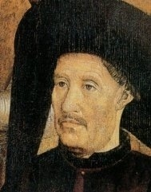
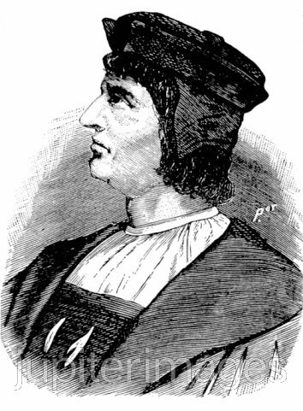
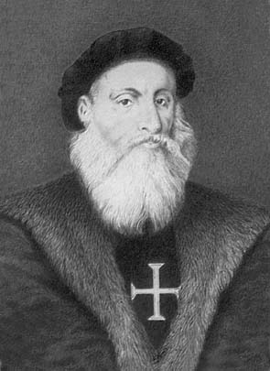
Portuguese Exploration
Portugal was the first country to send out explorers.
Prince Henry the Navigator
Founded a school of Navigation to train cartographers and sailors.
Wanted to find new sources of gold, spread Christianity, and find new trade routes.
Key Portuguese Explorers include:
Bartolomeu Dias: rounded the cape of good hope (Southern tip of Africa)
Vasco da Gama: found a trade route to Calicut, India.

Slide 15
Impact of Portuguese Exploration
Portugal founded trading posts in Western Africa and brought back gold and slaves.
Portugal took control of the eastern sea routes to Asia and formed monopolies on spices and silk
Portugal formed colonies in Brazil forcing natives to work as slaves on sugar plantations and convert to Christianity.

Slide 16
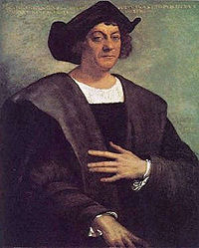
Early Spanish Exploration
In the late 1400s, King Ferdinand and Queen Isabella were determined to make Spain a powerful force in Europe.
Began to sponsor exploration and claim new lands for Spain.
Key Spanish Explorers:
Columbus: discovered the west Indies.
Magellan: discovered the Strait of Magellan; first to circumnavigate the globe.

Slide 17
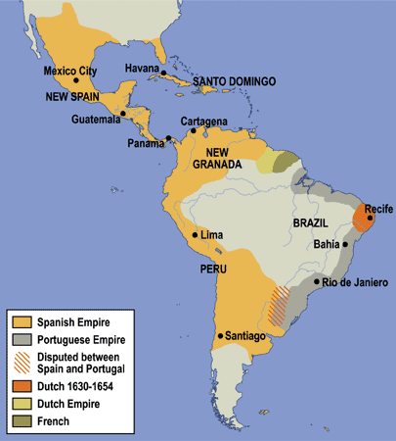
Impact of Early Spanish Exploration
Revealed the existence of
“New World” – the Americas!!
2. Began Spanish settlement in
the New World
* precious minerals, and establishing
plantations and colonies.
* Natives were forced to convert to
Christianity
* Natives were enslaved and killed
- Before Columbus: 1 or 2 million Taino
- After Columbus: only 500 Taino.

Slide 18
Line of Demarcation
Spain and Portugal were rivals over the new land
Pope Alexander VI set a Line of Demarcation dividing the non-European world into two zones
Spain had lands west of the line
Portugal had lands to the east
1500- Pedro Cabral discovers Brazil for Portugal
The Treaty of Tordesillas (1494) (re)established the specific terms of the Line of Demarcation.

Slide 20
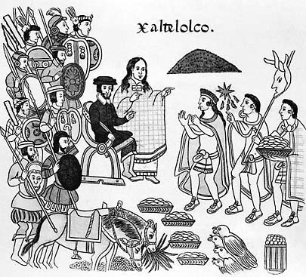
The Conquistadors
Conquistadors = Spanish conquerors
- used guns, horses, and disease
- As a result, the Native American
population fell by 90% during the
1500s.
Key Spanish Conquistadors:
Hernan Cortez: explored and conquered the lands of the Aztec in Mexico.
Francisco Pizarro: explored and conquered the lands of the Inca in Peru.

Slide 21
Mayan’s Description before Spanish
“There was then no sickness;
They had the no aching bones;
They had then no high fever;
They had then no smallpox;
They had then no burning chest…
At that time the course of humanity was orderly.
The foreigners made it otherwise when they arrived here…”

Slide 22
EUROPEAN DISEASE
bubonic plague
chicken pox
cholera
diphtheria
influenza
measles
scarlet fever
smallpox
typhus
tuberculosis
whooping cough

Slide 23
Small Pox Video
https://www.youtube.com/watch?v=woLJ1YapMTc

Slide 24
Effects of the Conquistadors
E-X-P-L-O-I-T-A-T-I-O-N E-X-P-L-O-I-T-A-T-I-O-N
* Good for Conquistadors/Europeans ☺
Sent treasure fleets to Spain from “New World”
Tons of slaves
Spain became the richest and greatest European power
* Bad for Native Americans ☹
Thousands of Native Americans were killed and enslaved.
Many were converted to Christianity by Missionaries.
Many assimilated to Spanish culture (language and customs)

Slide 25
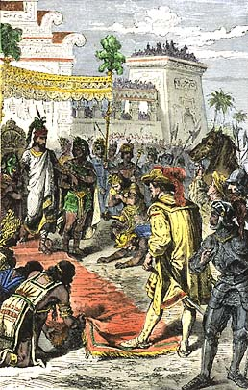
Impact of Later Spanish Explorers
1.) Wealth from the America’s made Spain one of the world’s richest and most powerful countries
2.) Conquistadors destroyed Aztecs and Incas – millions died from slavery and disease.
3.) The Columbian Exchange: many goods were exchanged between the new world and Europe.
New World sent gold, silver, corn, potatoes, chocolate, and tobacco to Europe.
Europeans sent horses, sheep, pigs, guns and germs to New World.

Slide 26
All good things, right???

Slide 27
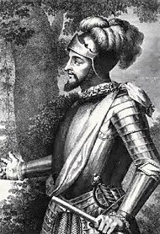
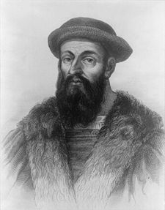
European Exploration of North America
The English, Dutch, and French explored the coast of North America unsuccessfully for the “Northwest Passage”
WHAT IS THE NORTHWEST PASSAGE ???
John Cabot: 1497 (England) trying to find the Northwest Passage
Giovanni da Verrazano: 1524 (France) explored the Atlantic coast from NC to Canada.
Henry Hudson: 1609 (England) tried to find the “Northwest Passage”, but instead explored the Hudson River.

Slide 28
Impact of European Exploration of North America
Unlike the Spanish conquistadors, northern explorers did not find gold or any other treasures. As a result, they did not establish colonies at first AND …
Europeans started trading with Native Americans and established trading posts in North America.
English exploration led to war between England and Spain.
English “sea dogs” raided Spanish ports and ships to take their gold.
King Philip II sent the Spanish Armada, a fleet of ships, to invade England. It failed and England became the richest and most powerful country in the World.

