Slide 1
Essential Question:
How did American nationalism increase during the “Era of Good Feelings” under President James Monroe?

Slide 2
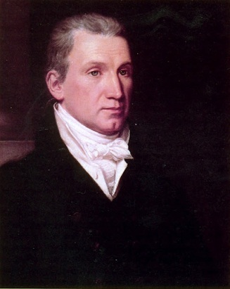
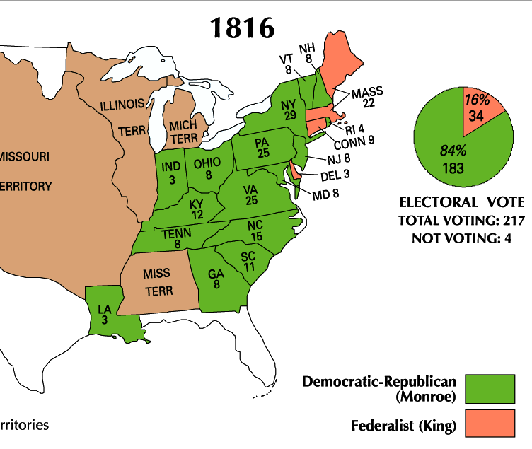
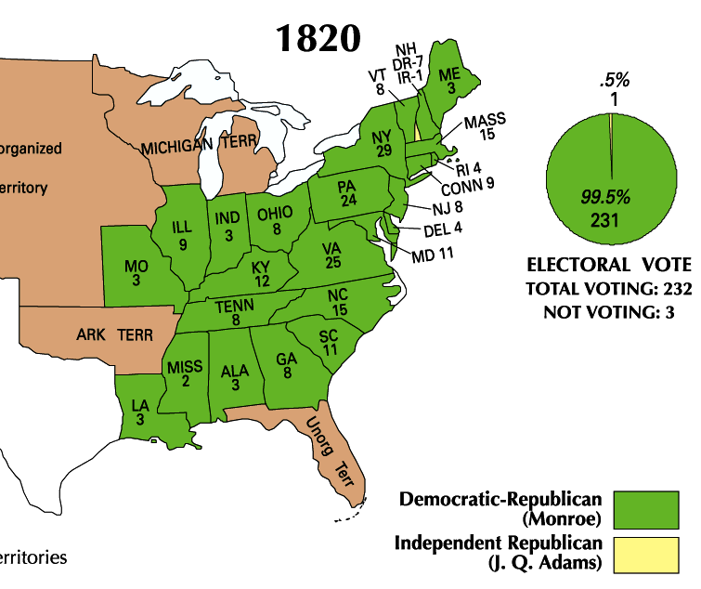
James Monroe was overwhelmingly elected president in 1816 and 1820
Monroe’s presidency began during an era of increased nationalism after the War of 1812 known as the “Era of Good Feelings” (1815-1825)

Slide 3
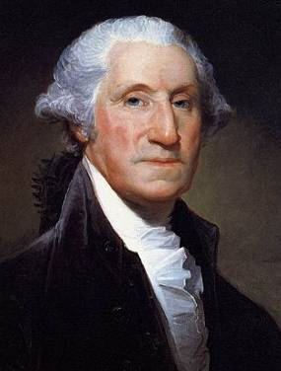
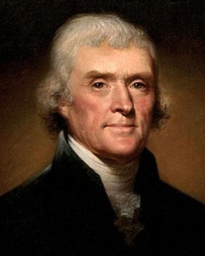
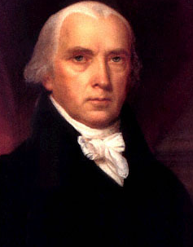
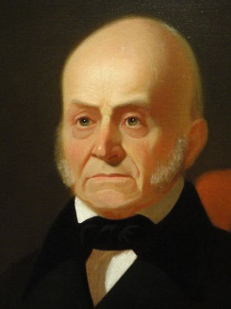
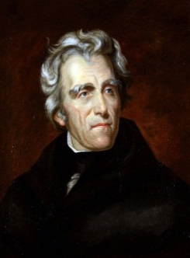
Monroe’s goals as president were to promote national unity and America’s place the world
By 1816 the Federalists were so weak that the Democratic-Republicans could do almost anything
Monroe and the Republicans in Congress used this time to promote American nationalism
8 yrs
George Washington
(1789-1797)
4 yrs
John Adams
(1797-1801)
8 yrs
Thomas Jefferson
(1801-1809)
8 yrs
James
Madison
(1809-1817)
8 yrs
James Monroe
(1817-1825)
4 yrs
John Quincy Adams
(1825-1829)
8 yrs
Andrew Jackson
(1829-1837)
Federalist Party
Democratic-Republican Party
Democratic Party

Slide 4
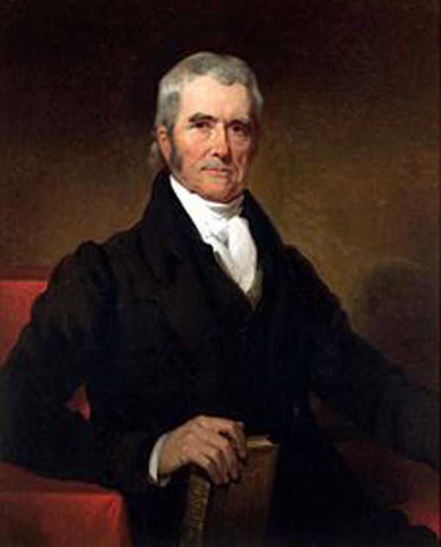
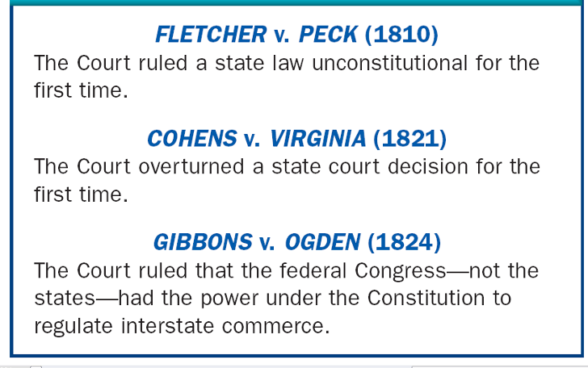
Monroe and the Republicans in Congress promoted nationalism & American unity in three ways:
1. Government: Increase the power of the national gov’t over the states
John Marshall (1801-1835) used the Supreme Court to strengthen the power of the national government

Slide 5
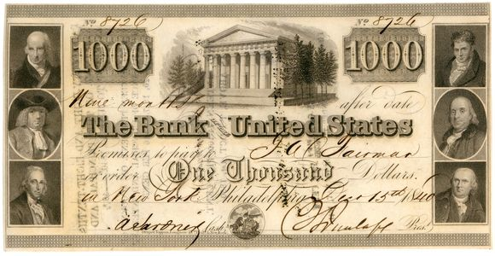
Monroe and the Republicans in Congress promoted nationalism & American unity in three ways:
Government: Increase the power of the national gov’t over the states
In 1816, Congressman Henry Clay proposed the American System to unify the economies of the North, South, and West
2. Economy: Encourage industry and transportation to link the South, North, and West
Create a Second Bank of the United States
Create a tariff to encourage industry and limit British manufactured goods
Improve transportation with roads and canals

Slide 6
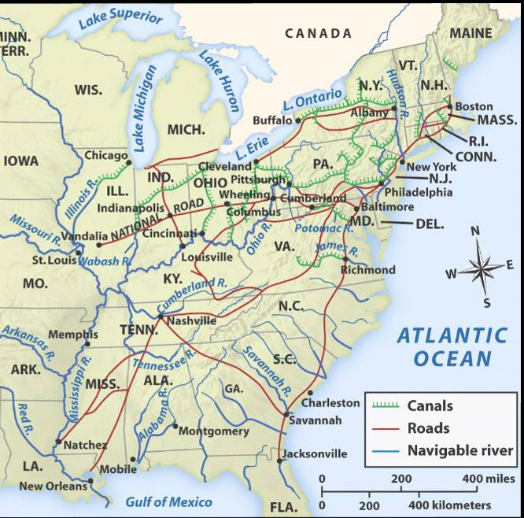
The American System allowed the USA to create a national market economy for the first time
Western farms grew grains
and raised livestock that fed the nation
Northern factories made manufactured goods that were sold throughout the country
Southern cotton was used in northern textiles factories
Notes:
We’ll talk about this “market revolution” more in-depth later this unit. This is just a preview in order to understand the importance of Henry Clay’s American System. The emphasis here is on the politics of the era, which should help students understand how the national government promoted a national market economy that, by the 1810s, had emerged as strong regional economies due to new technological innovations (cotton gin, interchangeable parts, Singer sewing machines, Slater mills, McCormick reaper, Deere steel plow, etc.) Again, we’ll discuss these details in the next set of notes.

Slide 7
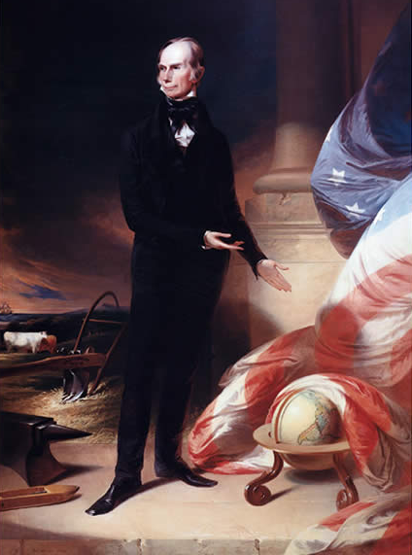
Kentucky Congressman Henry Clay
What aspects of this portrait reveal parts of Henry Clay’s “American System”?

Slide 8
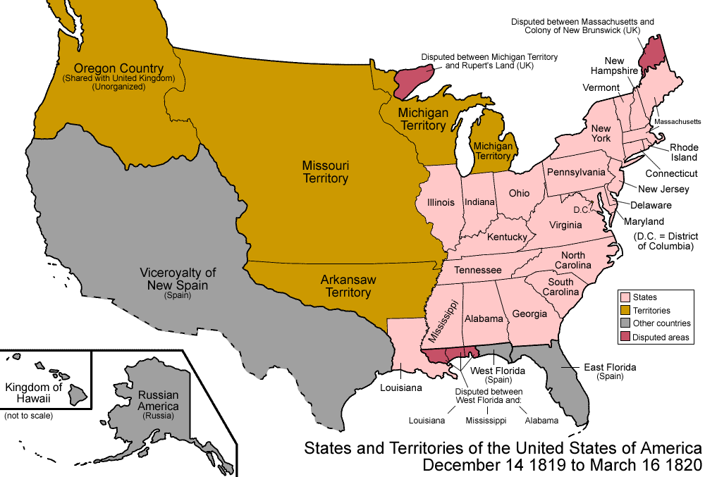
Monroe & the Republicans in Congress promoted nationalism & American unity in three ways:
Government: Increase the power of the national gov’t over the states
After the War of 1812, Americans flooded into the West; By 1840 over ¹/3 of the population lived in the West
Congress quickly admitted 5 new states to the Union
Economic and territorial growth created a need to settle America’s national borders
Economy: Encourage industry and transportation to link the South, North, and West
Indiana (1816)
Illinois (1818)
Alabama (1819)
Mississippi (1817)
3. Foreign Policy: Expanding America’s borders and increasing America’s role in world affairs
Louisiana (1812)

Slide 9
President Monroe and his Secretary of State John Quincy Adams used foreign policy to promote nationalism & territorial expansion
In 1818, the USA and Britain agreed to establish the Canadian border at the 49°
In 1819 the USA gained Florida from Spain with the Adams-Onis Treaty

Slide 10
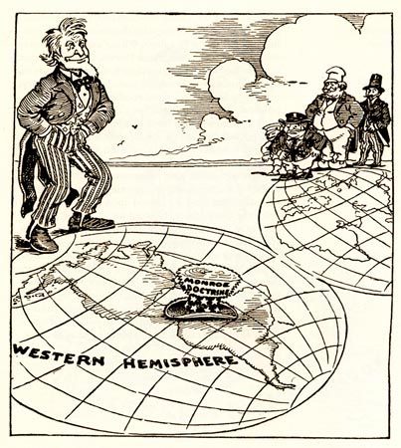
In 1823, the Monroe Doctrine warned European nations that the USA would protect the Western Hemisphere and that the U.S. would not interfere in Europe
When Latin American nations gained independence, the USA wanted to support the new republics and keep European nations from colonizing Latin America

Slide 11
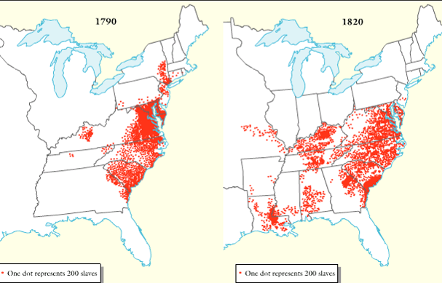
The Era of Good Feelings was a time of nationalism, but there were growing problems between the North and South (called sectionalism)
American Slave Population, 1790-1820

Slide 12
Northerners & Southerners disagreed over slavery, taxes, and the role of government
These disagreements dominated politics from 1820 to 1860
American Slave Population, 1790-1820

Slide 13
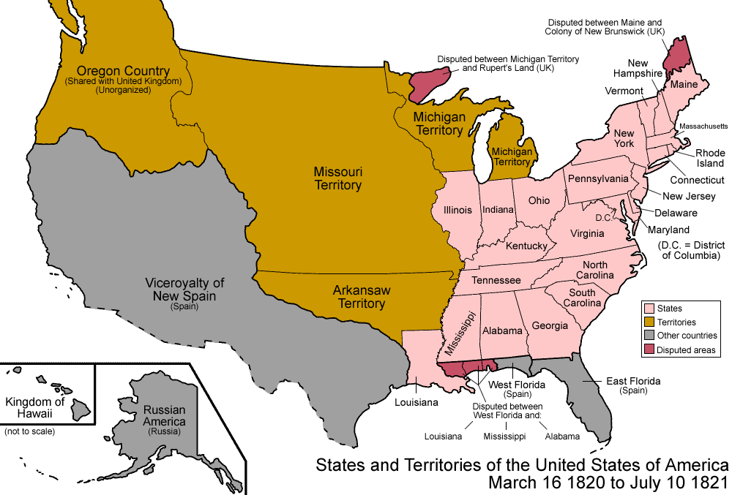
When Missouri applied to become a U.S. state, sectionalism emerged
Northerners did not want Southern states to increase power in the national gov’t
If Missouri entered as a slave state, the South would have 2 more Senators than the North
Notes:
Because of the 3/5 Compromise, the South had more members of the House of Representatives; President Monroe was from Virginia, so the South controlled the presidency too

Slide 14
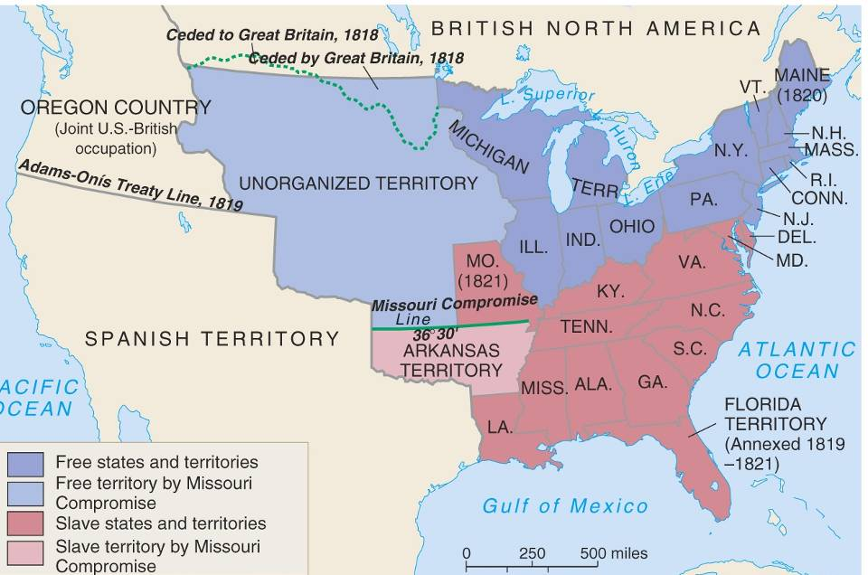
In 1820, Henry Clay negotiated the Missouri Compromise (Compromise of 1820)
Maine broke from Massachusetts and became a free state
Missouri became a slave state
Slavery was outlawed in all western territories above the latitude of 36°30'

Slide 15
Jefferson (1801-1809)
Madison (1809-1817)
Monroe (1817-1825)
For each president, provide a list of achievements and failures
Rank order the “success” of the Republican presidents: Jefferson, Madison, and Monroe
Be ready to share your answers

Slide 16
James Monroe was overwhelmingly elected president in 1816 and 1820
Monroe’s presidency began during an era of increased nationalism after the War of 1812 known as the “Era of Good Feelings” (1815-1825)

Slide 17
Monroe’s goals as president were to promote national unity and America’s place the world
By 1816 the Federalists were so weak that the Democratic-Republicans could do almost anything
Monroe and the Republicans in Congress used this time to promote American nationalism
8 yrs
George Washington
(1789-1797)
4 yrs
John Adams
(1797-1801)
8 yrs
Thomas Jefferson
(1801-1809)
8 yrs
James
Madison
(1809-1817)
8 yrs
James Monroe
(1817-1825)
4 yrs
John Quincy Adams
(1825-1829)
8 yrs
Andrew Jackson
(1829-1837)
Federalist Party
Democratic-Republican Party
Democratic Party

Slide 18
Monroe and the Republicans in Congress promoted nationalism & American unity in three ways:
Government: Increase the power of the national gov’t over the states
John Marshall (1801-1835) used the Supreme Court to strengthen the power of the national government

Slide 19
Monroe and the Republicans in Congress promoted nationalism & American unity in three ways:
Government: Increase the power of the national gov’t over the states
In 1816, Congressman Henry Clay proposed the American System to unify the economies of the North, South, and West
Economy: Encourage industry and transportation to link the South, North, and West
Create a Second Bank of the United States
Create a tariff to encourage industry and limit British manufactured goods
Improve transportation with roads and canals

Slide 20
The American System allowed the USA to create a national market economy for the first time
Western farms grew grains
and raised livestock that fed the nation
Northern factories made manufactured goods that were sold throughout the country
Southern cotton was used in northern textiles factories
Notes:
We’ll talk about this “market revolution” more in-depth later this unit. This is just a preview in order to understand the importance of Henry Clay’s American System. The emphasis here is on the politics of the era, which should help students understand how the national government promoted a national market economy that, by the 1810s, had emerged as strong regional economies due to new technological innovations (cotton gin, interchangeable parts, Singer sewing machines, Slater mills, McCormick reaper, Deere steel plow, etc.) Again, we’ll discuss these details in the next set of notes.

Slide 21
Kentucky Congressman Henry Clay
What aspects of this portrait reveal parts of Henry Clay’s “American System”?

Slide 22
Monroe & the Republicans in Congress promoted nationalism & American unity in three ways:
Government: Increase the power of the national gov’t over the states
After the War of 1812, Americans flooded into the West; By 1840 over ¹/3 of the population lived in the West
Congress quickly admitted 5 new states to the Union
Economic and territorial growth created a need to settle America’s national borders
Economy: Encourage industry and transportation to link the South, North, and West
Indiana (1816)
Illinois (1818)
Alabama (1819)
Mississippi (1817)
Foreign Policy: Expanding America’s borders and increasing America’s role in world affairs
Louisiana (1812)

Slide 23
President Monroe and his Secretary of State John Quincy Adams used foreign policy to promote nationalism & territorial expansion
In 1818, the USA and Britain agreed to establish the Canadian border at the 49°
In 1819 the USA gained Florida from Spain with the Adams-Onis Treaty

Slide 24
In 1823, the Monroe Doctrine warned European nations that the USA would protect the Western Hemisphere and that the U.S. would not interfere in Europe
When Latin American nations gained independence, the USA wanted to support the new republics and keep European nations from colonizing Latin America

Slide 25
The Era of Good Feelings was a time of nationalism, but there were growing problems between the North and South (called sectionalism)
American Slave Population, 1790-1820

Slide 26
Northerners & Southerners disagreed over slavery, taxes, and the role of government
These disagreements dominated politics from 1820 to 1860
American Slave Population, 1790-1820

Slide 27
When Missouri applied to become a U.S. state, sectionalism emerged
Northerners did not want Southern states to increase power in the national gov’t
If Missouri entered as a slave state, the South would have 2 more Senators than the North
Notes:
Because of the 3/5 Compromise, the South had more members of the House of Representatives; President Monroe was from Virginia, so the South controlled the presidency too

Slide 28
In 1820, Henry Clay negotiated the Missouri Compromise (Compromise of 1820)
Maine broke from Massachusetts and became a free state
Missouri became a slave state
Slavery was outlawed in all western territories above the latitude of 36°30'

Slide 29
Jefferson (1801-1809)
Madison (1809-1817)
Monroe (1817-1825)
For each president, provide a list of achievements and failures
Rank order the “success” of the Republican presidents: Jefferson, Madison, and Monroe
Be ready to share your answers

