Slide 1
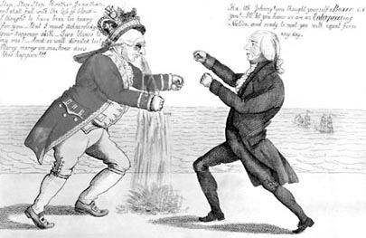
Madison and the War of 1812
"James Madison and King George III, and Enterprise vs. Boxer." Image. Library of Congress. American History. ABC-CLIO, 2012. Web. 22 Jan. 2012.

Slide 2
Essential Question:
  How did the War of 1812 encourage American unity & nationalism?

Slide 3
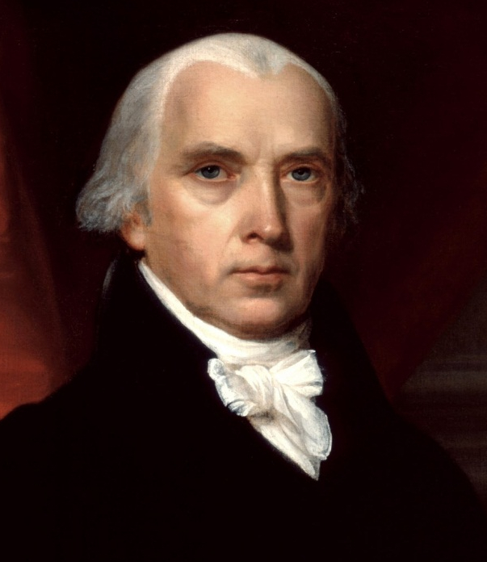
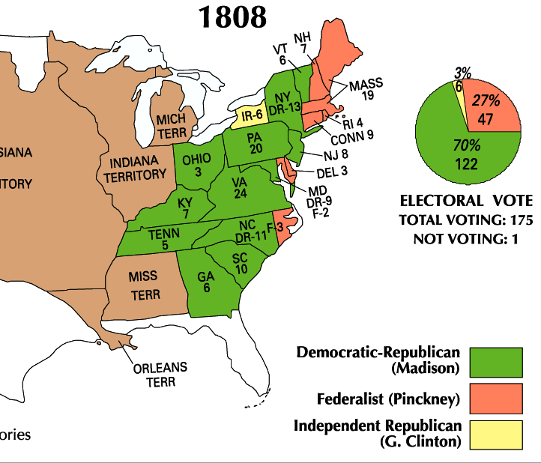
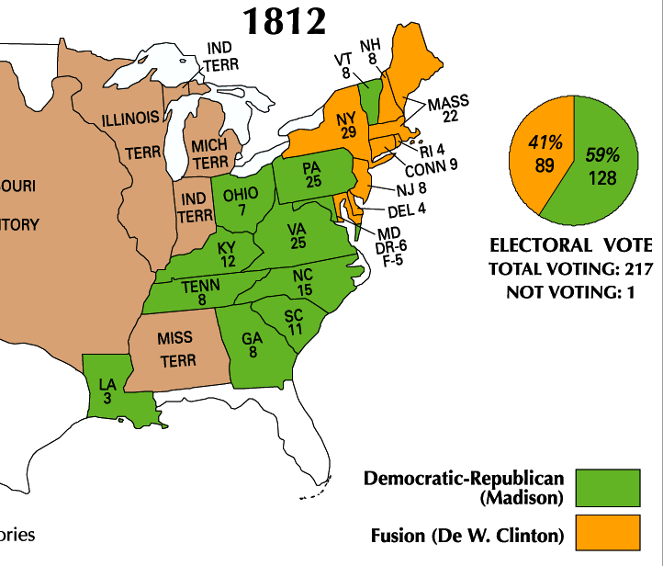
Jefferson’s hand-picked successor, James Madison, won the
presidency in 1808 & 1812
  Madison was well-qualified: He was the architect of the Constitution, served in Congress, & served as Jefferson’s Secretary of State

Slide 4
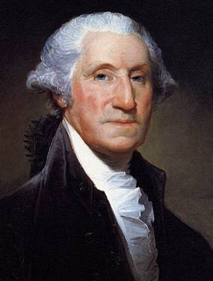
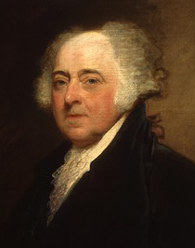
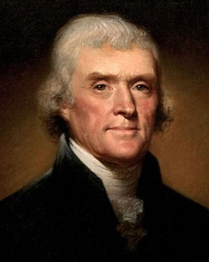
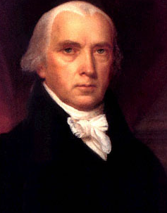
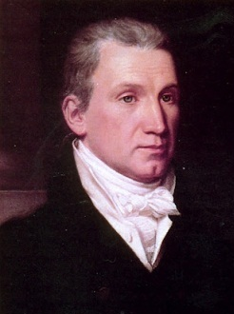
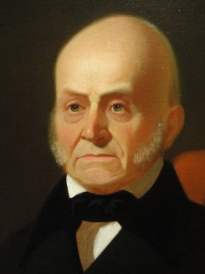
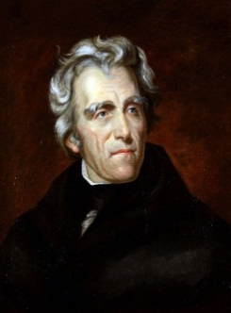
As president, Madison tried to continue Jefferson’s policies of limited national government
Madison continued the dominance of the Democratic-Republican Party & tried to continue Jefferson’s policies of limited national government
8 yrs
George Washington
(1789-1797)
4 yrs
John
Adams
(1797-1801)
8 yrs
Thomas
Jefferson
(1801-1809)
8 yrs
James
Madison
(1809-1817)
8 yrs
James
Monroe
(1817-1825)
4 yrs
John Quincy
Adams
(1825-1829)
8 yrs
Andrew Jackson
(1829-1837)
Federalist Party
Democratic-Republican Party
Democratic Party

Slide 5
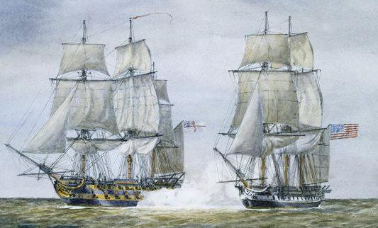
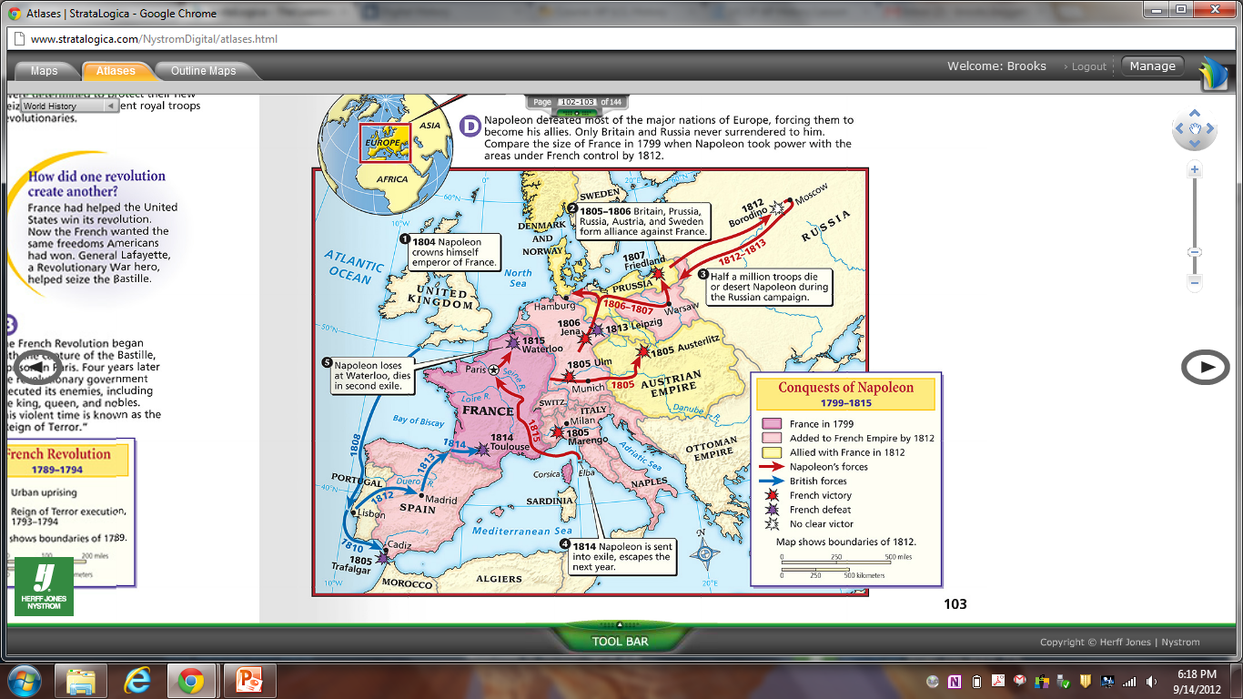
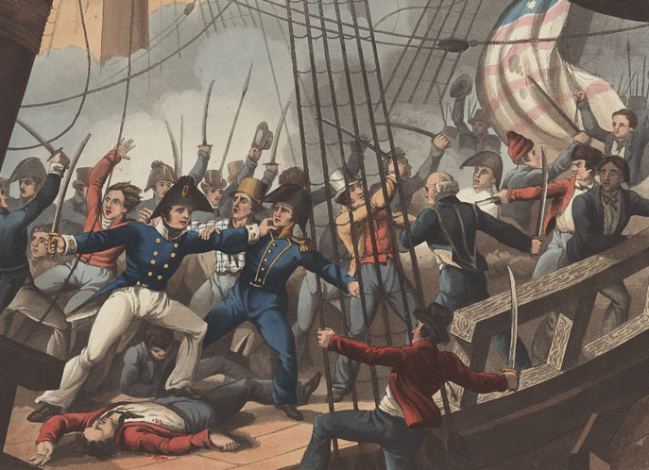
But, the
war between
England & France continued to cause America problems
England and France continued to violate American free trade
The British navy continued to
“impress” American merchants

Slide 6
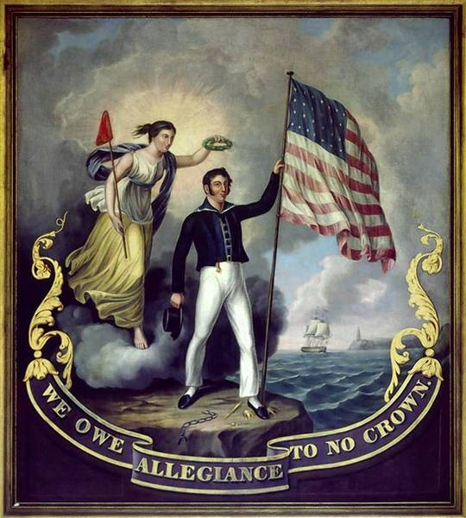
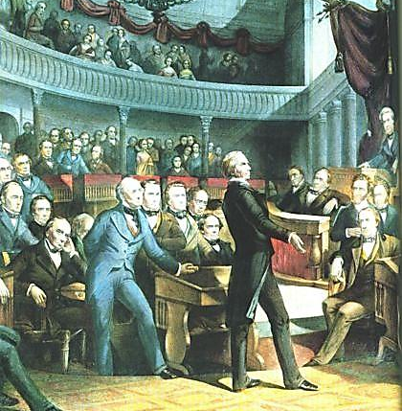
Many Congressmen called “War Hawks”
demanded war with Britain to defend U.S. honor
“Free Trade and
Sailors' Rights” was
a popular battle cry

Slide 7
Problem: Since 1793, Britain and France have been at war, violated free trade, and used impressment against American merchants. Attempts to resolve these issues did not solve these problems
Washington’s Proclamation
of Neutrality (1793)
Adams’ XYZ Affair (1798)
Jefferson’s embargo (1807)
Brainstorm three solutions
President Madison could use to solve this problem and select the 1 best alternative. Be sure to explain your decision

Slide 8
In 1812, Madison asked Congress for
a declaration of war against England
Patriotism surged
as Americans claimed the War of 1812 was a “Second American Revolution”

Slide 9
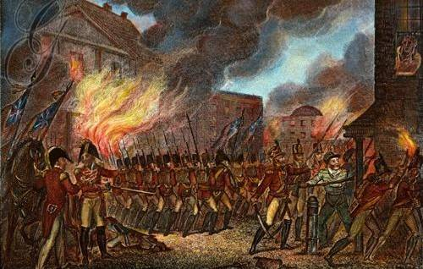
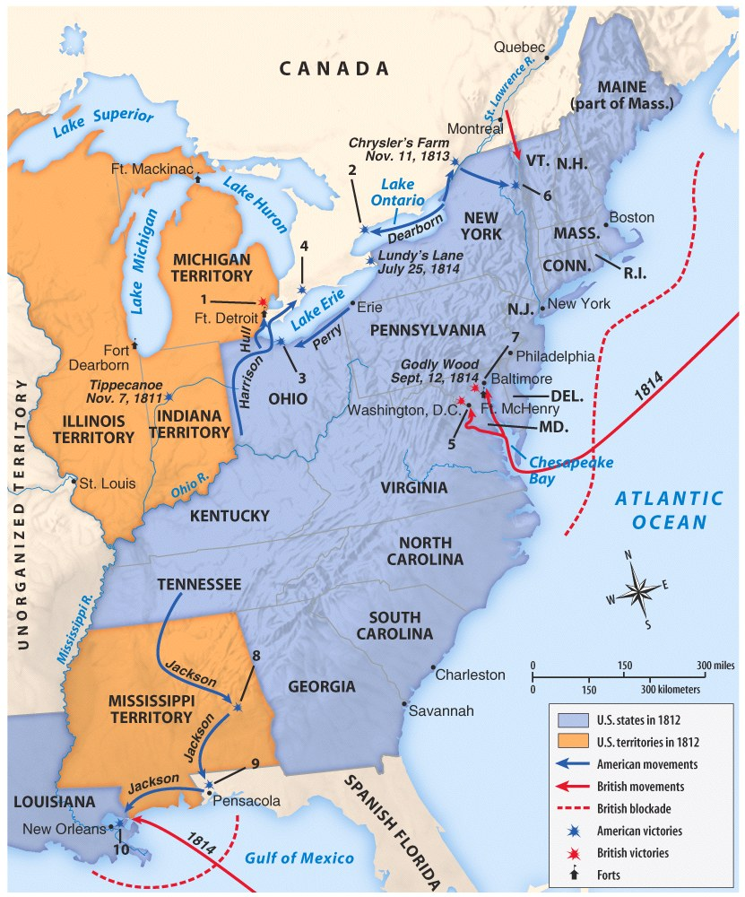
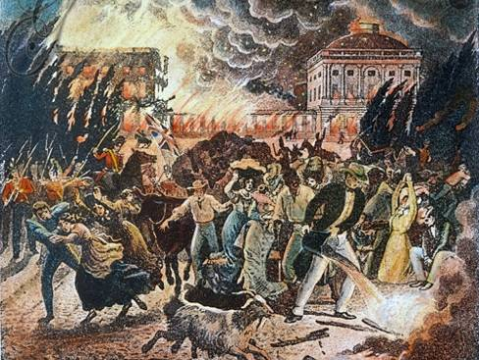

The War of 1812 (1812—1815)
The U.S. had a
small navy and
poorly trained army when the war began
Meanwhile, Britain’s
well-trained army had been fighting France for a decade
The war went badly in the early years
The British attacked and burned the national capital Washington, D.C.

Slide 10
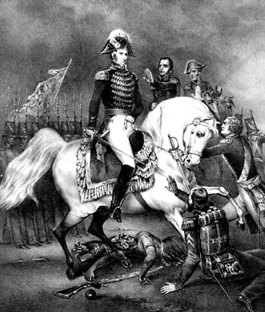
British Instigation of Indians or Demand for Indian Land?
Battle of Tippecanoe
Tecumesh (Shawnee chief)
  United tribes to fight
  settlement
-Harrison becomes a
national hero
"Battle of Tippecanoe." Image. Library of Congress. American History. ABC-CLIO, 2012. Web. 22 Jan. 2012.

Slide 11
Defeat of Native Americans
Tecumseh killed (end to hope) ➔ his supporters scattered
Invasion of Spanish Florida ➔defeat of Seminole Indians and seizing of Spanish fort at Pensacola

Slide 12
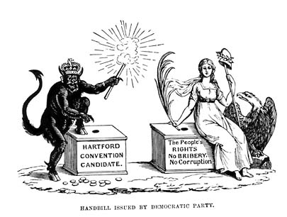
New England Considers Secession!
Hartford Convention
(Dec 1814-Jan 1815)
Treaty of Ghent (Dec 24, 1814)
Federalists meet because they want to secede
"Hartford Convention." Image. North Wind Picture Archives. American History. ABC-CLIO, 2012. Web. 22 Jan. 2012.
Ended War of 1812 (Stalemate)
Ignored major issues (impressment, trade, etc.)

Slide 13
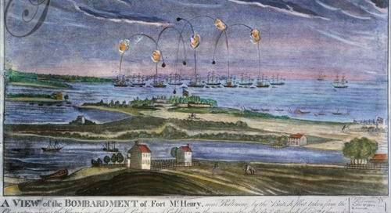
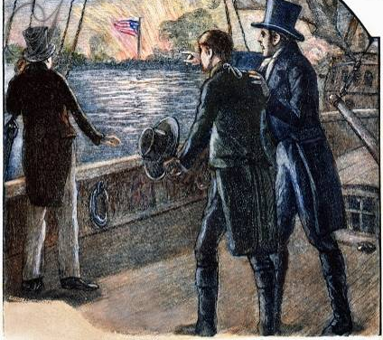
When the British laid siege to Fort McHenry, American Francis Scott Key wrote the poem “The Star Spangled Banner”

Slide 14
Though Britain was winning, they were also fighting France and wanted to
quickly end the War of 1812
In 1814, Britain and the United States signed the Treaty of Ghent ending the war

Slide 15
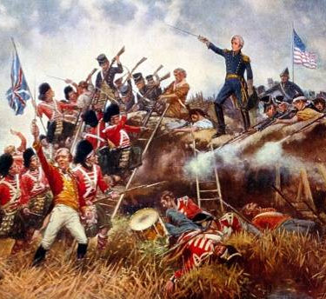
The War of 1812 (1812—1815)
Before news arrived, the Americans beat the British at the Battle of New Orleans
General Andrew Jackson emerged as a war hero
The victory at New Orleans led many Americans to feel as though they won the war

Slide 16
Battle of New Orleans—Johnny Horton (1959)
In 1814 we took a little trip
Along with Colonel Jackson down the mighty Mississip.
We took a little bacon and we took a little beans
And we caught the bloody British in the town of New Orleans.
[Chorus:]
We fired our guns and the British kept a'comin.
There wasn't nigh as many as there was a while ago.
We fired once more and they began to runnin' on
Down the Mississippi to the Gulf of Mexico.
We looked down the river and we see'd the British come.
And there must have been a hundred of'em beatin' on the drum.
They stepped so high and they made the bugles ring.
We stood by our cotton bales and didn't say a thing.
[Chorus]
Old Hickory said we could take 'em by surprise
If we didn't fire our muskets 'til we looked 'em in the eye
We held our fire 'til we see'd their faces well.
Then we opened up with squirrel guns and really gave 'em ... well

Slide 17
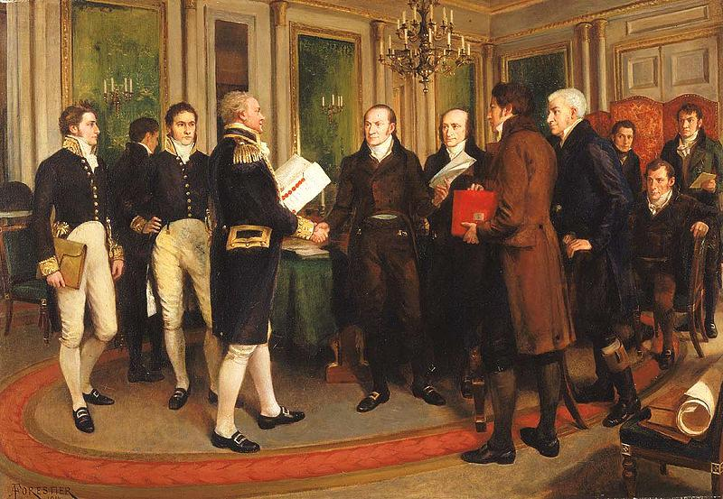
Treaty of Ghent ended the war, but it did not address trade rights or other causes of the war

Slide 18
The War of 1812
had important
effects on America
Americans were united in a sense of nationalism, believing that they had beaten the British
America entered
an “Era of Good Feelings” with a popular president
and booming
national economy

Slide 19
Legacies of the War
Treaty = No real changes made
Nationalism
  New national heroes
  National anthem
  2nd defeat of Britain
End of Indian Resistance ➔New States: IN, MS, IL, AL
End of Federalist Party ➔Era of Good Feelings
Florida

Slide 20
Are you a hawk or a dove?
Imagine that you, Senator _____, have been asked to give a speech in Congress declaring your feelings about the War of 1812. You must choose a side and give your opinion about the war. Make sure that your speech includes:
A description of 4 causes of the war (use your notes and the book)
A discussion of what part of the country/types of people might be helped the most by the war (think: North, South, West, farmers, traders, merchants, shipbuilders)
An explanation of what part of the country/types of people might be hurt by the war
At least 3 reasons why you think Americans should be “for” or “against” the war

