Slide 1
What is Economics?
How do economists study the ways people make decisions on how to use their time, money, and resources?

Slide 2
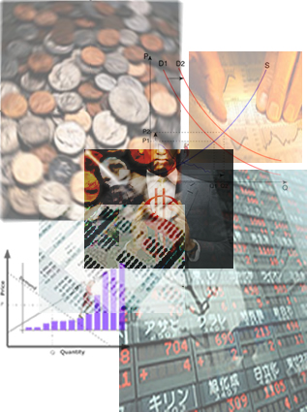
Economic Choices
Responsible citizens make economic decisions everyday. We have to make these choices because we have limited resources.
Economics is the study of how people make decisions in a world of limited resources.
Scarcity
- Needs: things we must have in order to survive→
Food, Water, Shelter, Clothing
- Wants: things we can live without but find desirable.
- Scarcity: the fact that we do not have enough resources (water, food, money, time) to satisfy everyone’s needs and wants. Think “Musical Chairs”.

Slide 3
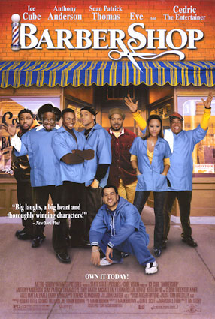
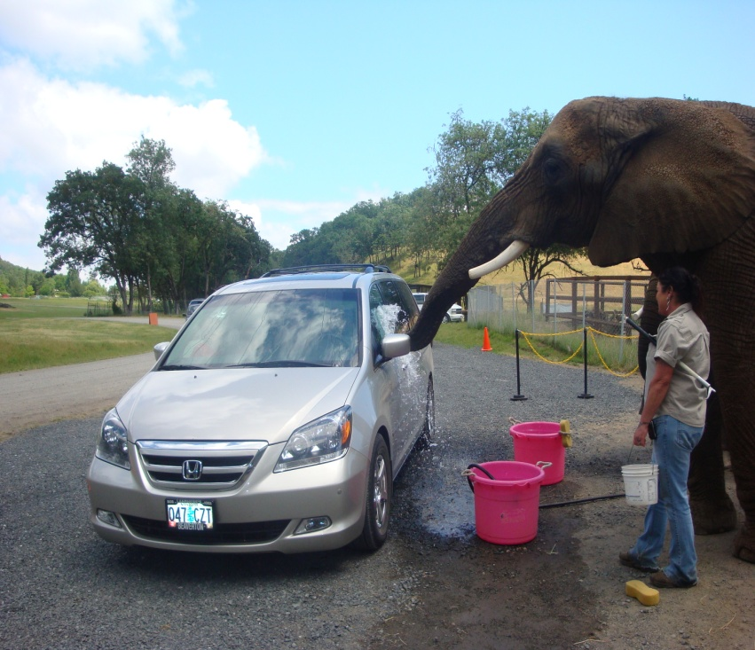
Goods and Services
Goods: tangible objects that we use to satisfy our wants and needs
Examples of goods: pencil, candy bar, computer, car, etc.
Durable Good: a good that can be used repeatedly, or yields benefits over a long period of time.
- Examples: cars, washing machine, computers
Non-durable Good: Goods that either can only be used once, or yield a benefit for less than three years.
- Examples: food, office supplies, cosmetics, gasoline.
Services: work that is performed for someone else.
Examples of Services: haircut, landscaping, babysitting, dry-cleaner, etc.

Slide 4
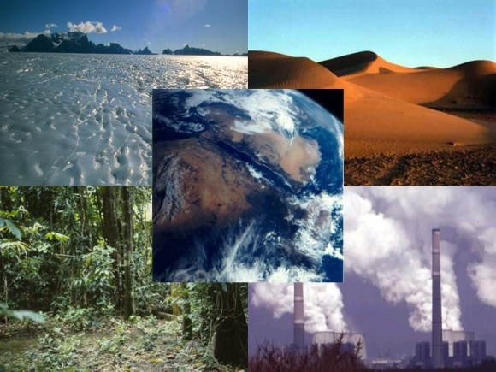
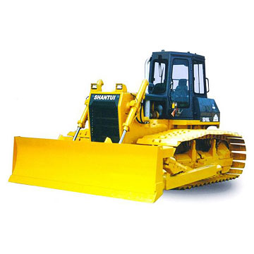
The Four Factors of Production
The 4 resources necessary to produce goods and services
1. Natural Resources: all of the “gifts of nature” that make production possible
EX:
2. Labor aka Human Resources: physical and mental efforts that people contribute to the production of goods and services
3. Capital/Capital Goods: tools, machinery, and goods used to make other things
4. Entrepreneurs: individuals who start new businesses, introduce new products, and improve management techniques

Slide 5
Economy and Economic Models
Economy: all of the activity in a nation that affects the production, distribution, and use of goods and services.
Economists use models (usually graphs and tables) to try to predict how things will play out in the economy.
One of the most important models is the “Production Possibilities Model/Curve”. It shows what things can possibly be produced at a given time.
It is easier to create models that are simplified, so let’s assume our economy is only producing two goods: iPods and Industrial Robots.

Slide 6
Production Possibilities Table
 | iPods | Industrial Robots
A | 0 | 10
B | 1 | 9
C | 2 | 7
D | 3 | 4
E | 4 | 0

Slide 7
Production Possibilities Curve
The Production possibilities curve is a graphical representation of the table.
- Points on the curve represent maximum possible combinations of two goods given resources and technology.
- Points inside the curve represent underemployment or unemployment
- Points outside the curve are unattainable at present
If we assume we have a set number of resources to produce goods, this model shows us that we are limited in the number of a certain good we can produce. When we choose to produce more of one good, we must give up production of the other.

Slide 8
-1
+1

Slide 9
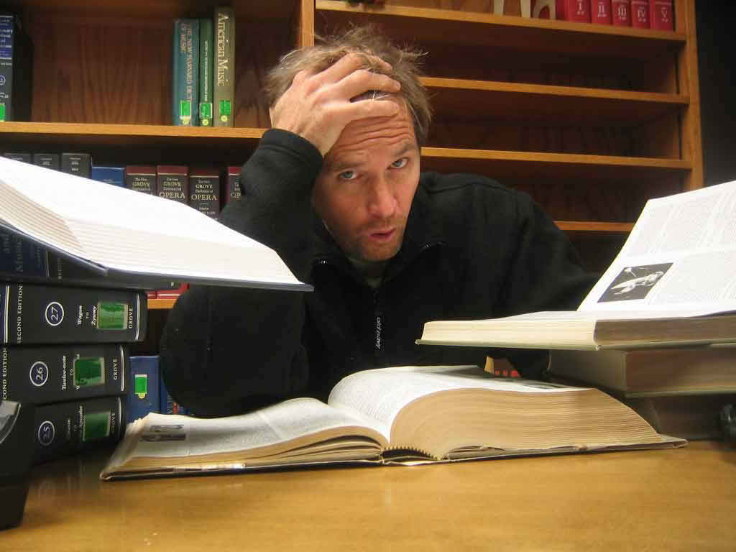
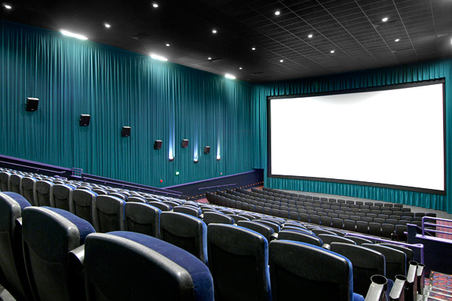
Making Economic Decisions
Trade Offs: the alternative you face if you decide to do one thing rather than another. You cannot do more than one activity at a time. By deciding to do something, you are also deciding not to do several other possible things.
You face trade-offs in deciding how to spend your time and money. Society faces trade-offs in determining how to distribute scarce resources.

Slide 10
Making Economic Decisions
Whenever you make a decision to spend money or time, you are costing yourself the opportunity to do many other things, but you could only have done one of those trade-offs.
Opportunity Cost: A specific type of trade-off; if you list all of the trade offs for a specific decision, the opportunity cost is trade off which you would most like to do if you had not made your decision. It is the next best alternative to the thing you actually chose.
The Production Possibilities Model shows the opportunity cost a society faces when deciding to produce one good over another.

