Slide 1
Fiscal and Monetary Policy
What actions can be taken by the government to affect the economy?

Slide 2
Fiscal Policy
Adjusting govt. taxing and spending to address economic downturns.
In theory, the best thing to do in a recession is to both cut taxes and increase govt. spending.
Why cut taxes? This gives people more income to spend, which will hopefully stimulate the economy due to increased demand
Why increase govt. spending? Provide more jobs to unemployed people, so they have more money to spend.

Slide 3
Fiscal Policy
Cutting taxes AND increasing spending is impossible without putting the nation into serious debt. So, we usually have to pick one.
This issue is one major difference between Democrats and Republicans.
- Democrats prefer to increase govt. spending hoping to employ more people and encourage them to spend their income.
- Republicans prefer to cut taxes hoping to stimulate investment in the economy from the top which will result in more jobs being created.

Slide 4
Problems with Fiscal Policy
Because Fiscal policies are set by the Congress, it often takes a long time for them to take effect.
The Congress often has trouble making quick decisions because of the different perspectives/interests of members.
Both possible actions also assume that people will spend the extra income that they receive. If they choose to save their money instead, the economy will not be stimulated.

Slide 5
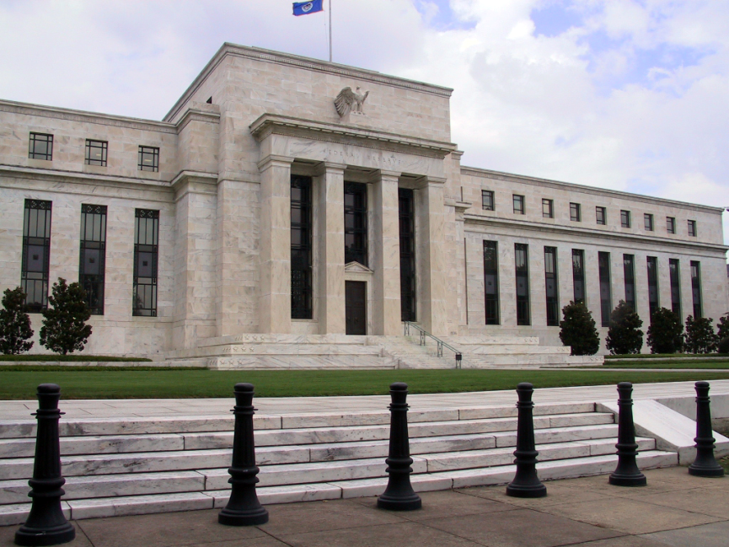
The Federal Reserve and Monetary Policy
The Federal Reserve (Fed) serves as the nation’s central bank.
It is designed to oversee the banking system.
It regulates the quantity of money in the economy.

Slide 6
The Federal Reserve and Monetary Policy
Monetary policy is conducted by the Federal Open Market Committee.
The money supply refers to the quantity of money available in the economy.
Monetary policy is the setting of the money supply by policymakers in the central bank.
The Fed works to affect the economy by changing the supply of money.
More money tends to stimulate the economy
Less money tends to slow the economy

Slide 7
The Fed’s 3 Tools of Monetary Control
0
1. Open-Market Operations (OMOs): the purchase and sale of U.S. government bonds by the Fed.
To increase money supply, Fed buys govt bonds, paying with new dollars.
…which are deposited in banks, increasing reserves
…which banks use to make loans, causing the money supply to expand.
To reduce money supply, Fed sells govt bonds, taking dollars out of circulation, and the process works in reverse.

Slide 8
The Fed’s 3 Tools of Monetary Control
0
2. Reserve Requirements (RR). Affect how much money banks can create by making loans.
To increase money supply, Fed reduces RR.
Banks make more loans from each dollar of reserves, which increases money multiplier and money supply.
To reduce money supply, Fed raises RR, and the process works in reverse.
Fed rarely uses reserve requirements to control money supply: Frequent changes would disrupt banking.
Notes:
Reserve requirements were introduced & defined on the slide titled “Bank Reserves,” immediately following “The Structure of the Fed.”
Reserve requirements are not a good tool for monetary policy:
To make the money supply grow over time, the Fed would have to continually reduce reserve requirements. This is neither possible – they cannot be reduced below 0 – nor desirable – if reserves are too low, then banks will have liquidity problems, and bank runs (discussed later in the chapter) might become fashionable again.
To reduce the money supply using reserve requirements, banks wouldn’t be able to make as many loans, which would make the banking industry less profitable, and could cause it to contract.

Slide 9
The Fed’s 3 Tools of Monetary Control
0
3. The Discount Rate: the interest rate on loans the Fed makes to banks
When banks are running low on reserves, they may borrow reserves from the Fed.
To increase money supply, Fed can lower discount rate, which encourages banks to borrow more reserves from Fed.
Banks can then make more loans, which increases the money supply.
To reduce money supply, Fed can raise discount rate.
Notes:
Why might banks run low on reserves? On any given day, it might turn out that depositors make higher-than-expected withdrawals, or the bank makes more loans than expected.

Slide 10
Effects of Monetary Policy
The Fed most commonly uses Open Market Operations (buying and selling bonds) to affect the supply of money.
If the economy is doing poorly, the Fed uses Monetary policies to attempt to stimulate the economy.
If the economy is doing really well, the Fed uses Monetary policies to slow things down. This prevents inflation and hopefully prevents a massive over-correction like we saw in 2008.

Slide 11
Effects of Monetary Policy
Monetary Policy is often more effective then Fiscal Policy in the short-term because the Fed can enact policies immediately.
The Fed is also independent of the Congress, so they can make decisions that are more unpopular with voters, because they cannot be voted out of office.
This is potentially good for the economy, but not so good for a democracy.

