Slide 1
Effects of the American Revolution

Slide 2
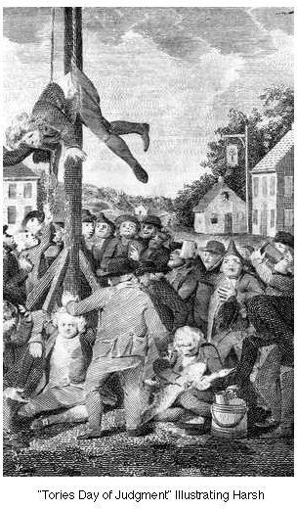
Loyalists
Some left for Britain, Canada, or New York
Kept Silent
Treaty said would be compensated for property losses

Slide 3
African Americans
War conditions contradict ideals
Restrictions on African Americans
Opposition to slavery grew
Gradual abolition in north
US could not finance immediate abolition in South
“Great as the evil is, a dismemberment of the union would be worse.” J. Madison, 1787

Slide 4
Native Americans
Revolution and implicit promise equal opportunity = territorial expansion.
Threat to Native Americans
Dangers from diseases, farming practices and alcohol
Northwest Ordinance meant Iroquois, Delaware, Shawnee gave in; others resisted.
Spain allied with Creeks

Slide 5
Women
No rights gained from revolution
Women considered naturally dependent
War effort boosted women’s confidence
Laundering, nursing, cooking
Some disguised as men
Managed homes, farms, businesses

Slide 6
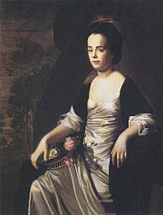
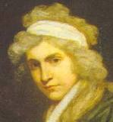
Abigail Adams
“Remember the ladies”
Judith Sargent Murray
“On the Equality of the Sexes”
Mary Wollstonecraft (European)
A Vindication of the Rights of Women
Abigail Adams
Mary Wollstonecraft
Notes:
Mary Wollstonecraft was the mother of Mary Shelley – author of Frankenstein She was widely read by Murray and Adams and other “Republican Mothers”

Slide 7
Republican Motherhood
Educating women in values of liberty and independence in order to strengthen virtue in new nation. Women will raise Republican sons.
Plato’s Republic

