Slide 1
Declaration of Independence

Slide 2
Essential Question:
What are the main arguments of the Declaration of Independence?

Slide 3
[L]ive peaceable under the civil government, …nor shall he or she at any time be compelled to frequent or maintain any religious worship place or ministry whatever…that so we may live friendly together…. The Indians shall have liberty to do all things to the improvement of their ground.
William Penn, 1682

Slide 4
How did William Penn’s principles regarding his “holy experiment” colony affect those who chose to settle in Pennsylvania?
Many citizens left the colony to find education for their children.
The colony experienced minimal growth due to the religious intolerance of its leaders.
American Indians and colonists often worshiped together.
Penn’s approach made the colony diverse by attracting many types of people and religions.

Slide 5
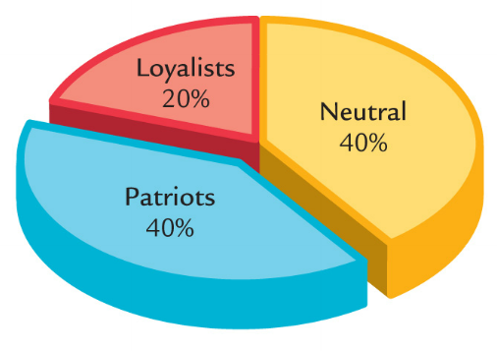
By 1776, American colonists were divided into 3 groups
Loyalists wanted to remain British colonies
Neutrals were undecided about which side to choose
Patriots supported separation from Britain (independence)

Slide 6
Quick Review: How did we get to this point?

Slide 7
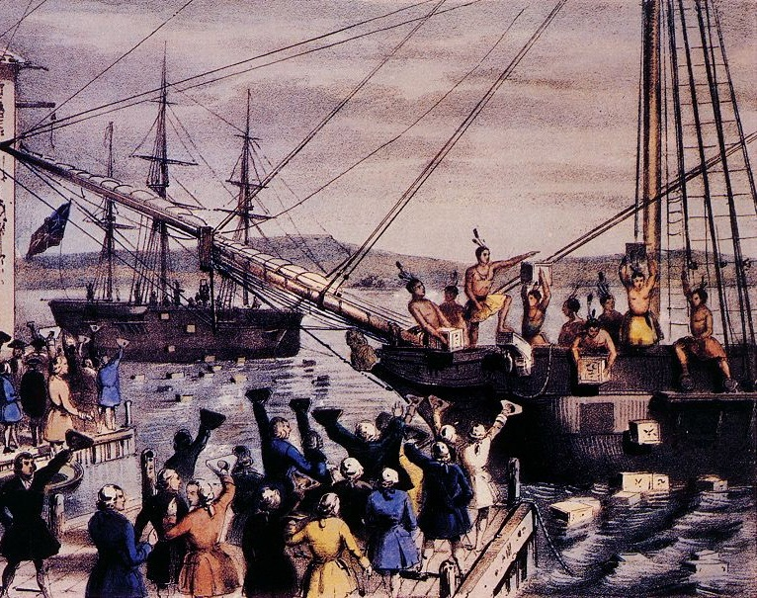
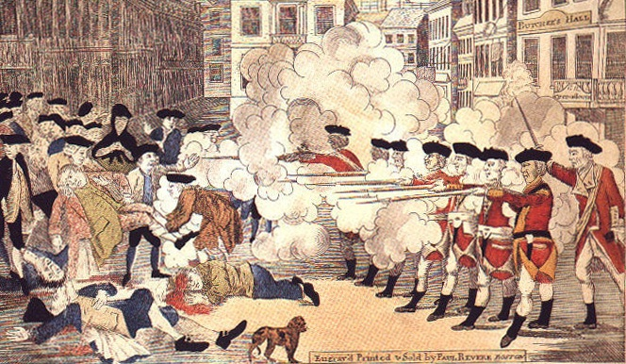
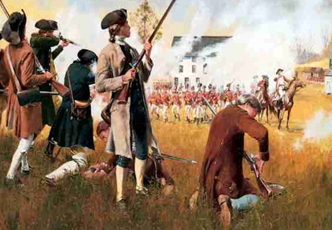
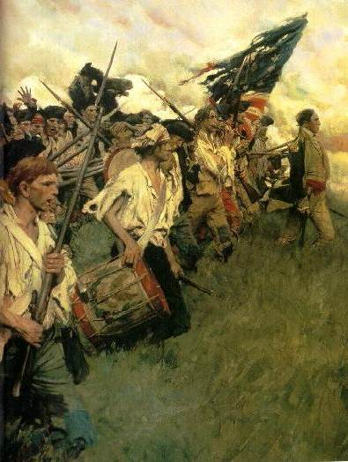
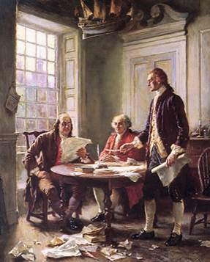
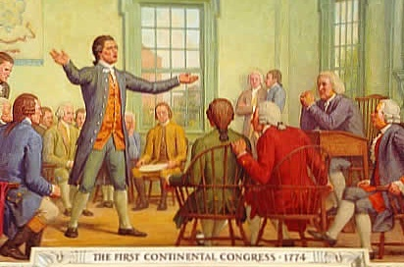
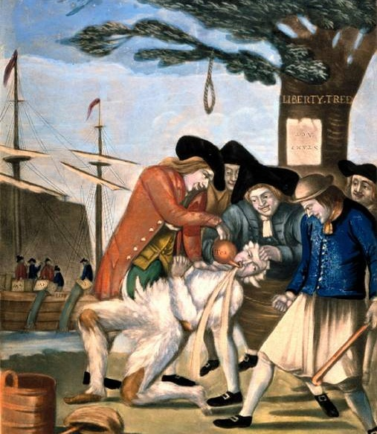
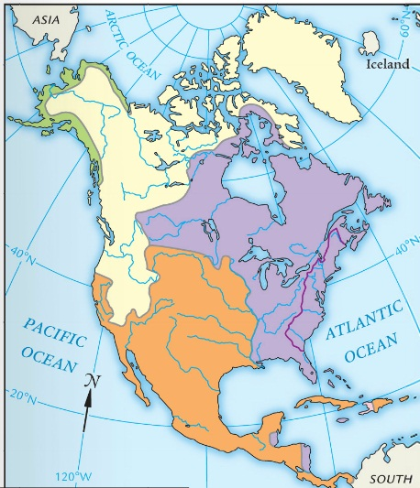
By 1750, the American colonists were loyal British citizens with autonomous, self-governing colonial assemblies and a thriving trade connection with England
Second Continental Congress (1775)
Proclamation of 1763
Lexington and Concord (1775)
The policy of salutary neglect ended as Britain imposed greater political authority over the colonies, raised new taxes to pay off war debts, and refused to allow colonists representation in Parliament
First Continental Congress (1774)
Sons of Liberty formed
Intolerable Acts (1774)
Townshend Acts (1767)
Boston Tea Party (1773)
Paine’s Common Sense (1776)
Turning Point! England defeated France in the French and Indian War (1754-1763)
Stamp Act (1765)
Boston Massacre (1770)
Declaration of Independence (1776)
Revolutionary War (1775-1783)
1750
1755
1760
1765
1770
1775
1780
1785

Slide 8
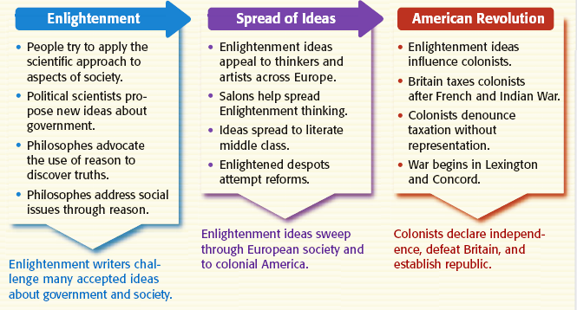
The American Revolution was inspired by the Enlightenment
John Locke—all men are born with natural rights & citizens can revolt from tyrannical gov’ts
Montesquieu—separation of powers; checks & balances
Thomas Paine’s Common Sense urged colonial independence
Rousseau believed that citizens have a social contract with their gov’t

Slide 9
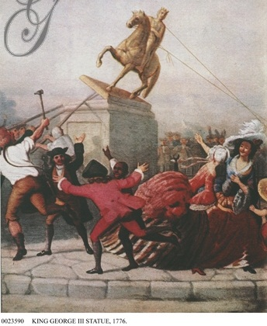
By July 1776, how had colonial attitudes towards Great Britain changed?

Slide 10
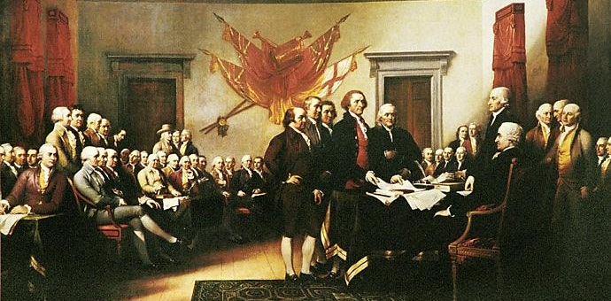
By July 1776, enough Americans were “patriots” that members of the Second Continental Congress formed a 5-man committee to draft a Declaration of Independence
Thomas Jefferson of Virginia was the principal author
All men are born with “natural rights” of life, liberty, & property
Citizens can break their social contract with their gov’t when their gov’t becomes tyrannical
It was based on the “enlightened” ideas of John Locke & explained why the colonists were rebelling

Slide 11
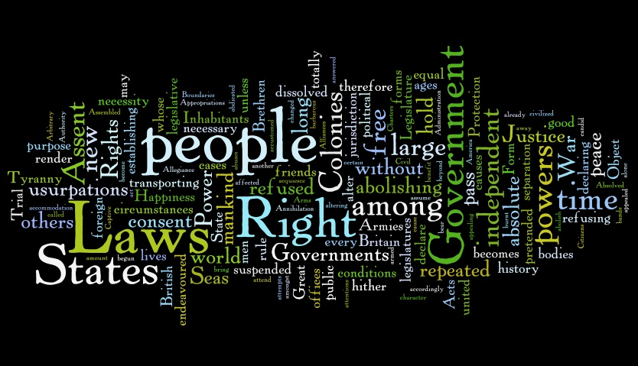
Quick Class Discussion: Based on this word cloud, hypothesize THREE major themes present in the Declaration of Independence?

Slide 12
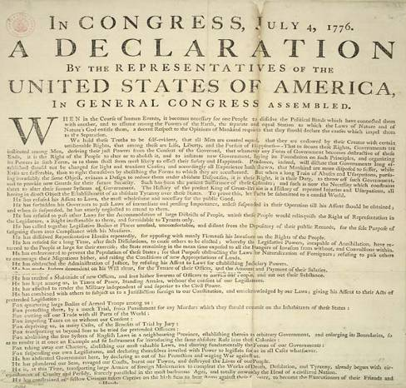
Declaration of Independence (July 4, 1776)
Committee to draft the Declaration: Thomas Jefferson, Ben Franklin, John Adams, Robert Livingston, & Roger Sherman

Slide 13
Two Treatises on Government John Locke
What is a way by which governments are dissolved?
Why do men enter into society?
When are the people released from obedience to the government?
Why does the “supreme executor” have a double responsibility?

Slide 14
Examining Excerpts from the Declaration of Independence: Read each passed of the Declaration of Independence. Working with a partner, summarize the main idea and write it in your own words in the chart

Slide 15
Decoding the Declaration of Independence
We should explain why we are declaring independence
All people have natural rights
Government power comes from the people
If a gov’t cannot protect people, then the people should create a new gov’t that can
King George III has abused his power
These are the reasons we believe that the king has abused his powers
We have explained to the king why we are unhappy but he has ignored us and hurt us
Because of the king’s abusive actions, we are declaring our independence as a new nation

Slide 16
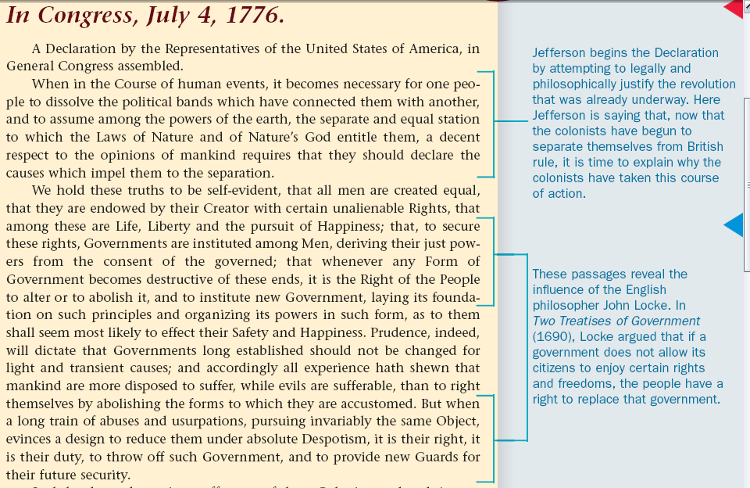
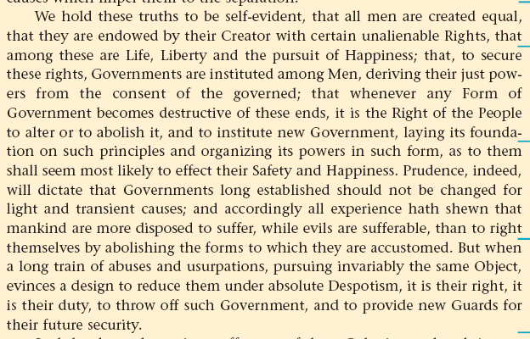
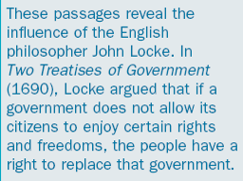
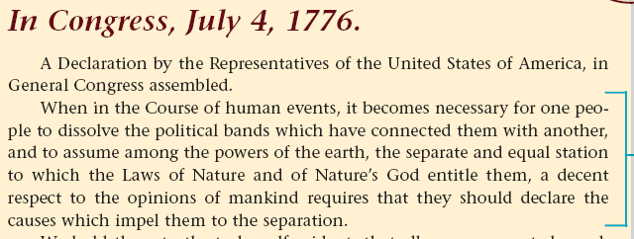
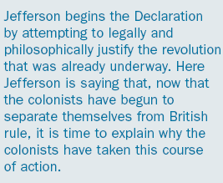
The Declaration of Independence & Influences from the Enlightenment
Too Late to Apologize Video (3.22)
Notes:
Dec of Ind video from America: Story of Us (4.00) via youtube.com

Slide 17
Read Paragraph 2 of Declaration
What are two “self-evident” truths?
What are three “unalienable” rights that people have?
Why do we have government? Where does it get its power?
Under what conditions may government be changed?

Slide 18
Read the List of Grievances in the Declaration of Independence and respond to the following
What similarities are there between the situation that Locke describes and the grievances listed by the colonists?
What textual evidence can you provide to support this?

Slide 19
America: The Story of Us American Revolution (3.31)
Watch the video from the America: The Story of Us series and answer these questions:
What advantages did the American colonists have over the British?
What advantages did the British have over the American colonists?
Why did the Americans win the Revolutionary War?

Slide 20
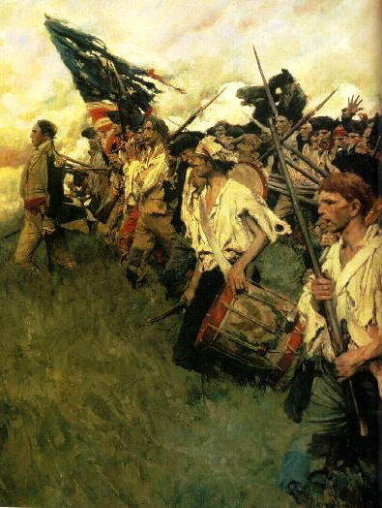
The Declaration of Independence was a formal demand for separation, but the Revolutionary War had already begun in 1775
Lexington & Concord
Formation of a Continental Army under George Washington
Americans were divided among Patriots, Loyalists, & Neutrals

