Slide 1
American Revolution

Slide 3
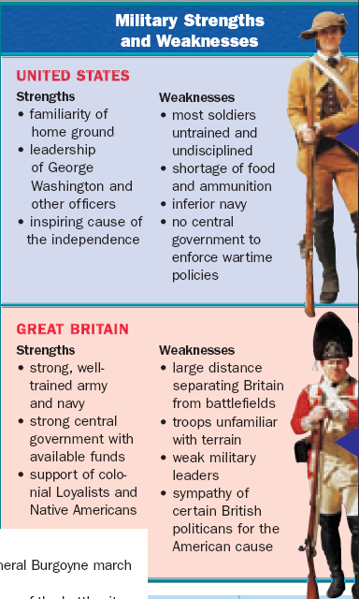
Quick Class Discussion
What was the biggest advantage the American colonists had during the Revolutionary War?
What was the biggest advantage that Great Britain had during the Revolutionary War?
Based on this chart, who should win the war?

Slide 4
Revolutionary War
When the war began, the British had a clear military advantage:
400% larger & more experienced army
More money
The world’s most dominant navy
Manufacturing to make war supplies

Slide 5
Revolutionary War
Britain under-estimated the colonial commitment to independence
But, the American colonists had:
Familiarity with the environment
A commitment to win the war
Short supply lines to their soldiers
A defensive strategy to outlast the British
To win, the English had to find & defeat the Continental Army

Slide 6
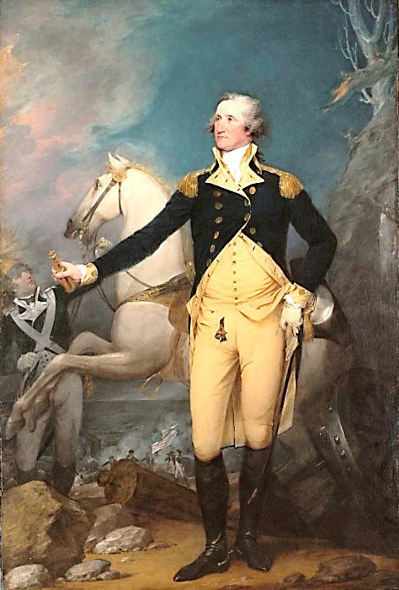
As leader of the Continental Army, George Washington was the symbol of the American cause
He had to build a professional army & coordinate the militias
Encouraged common citizens & volunteer soldiers to support the war even when the British seemed destined to win during the early years of the revolution

Slide 7
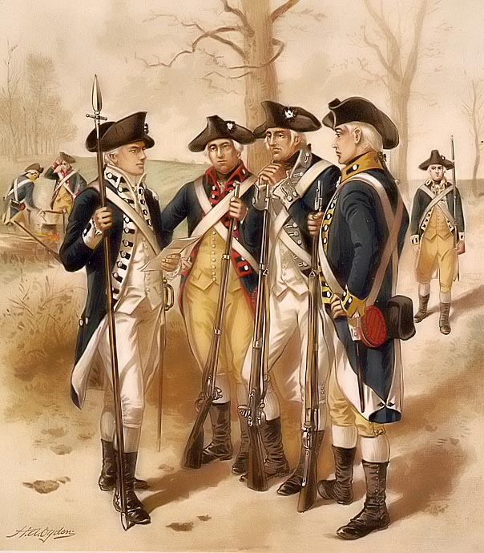
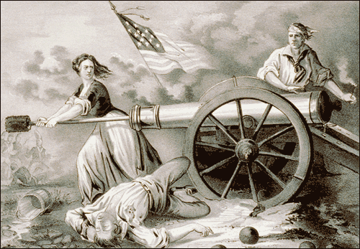
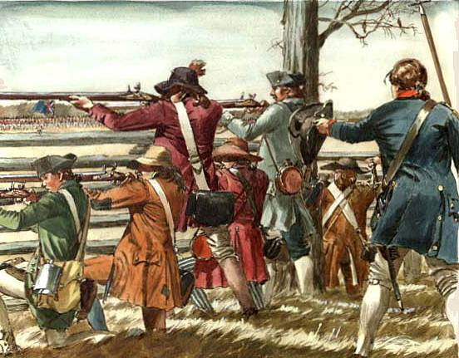
American Military: Continental Army, Colonial Militias, & Civilians

Slide 8
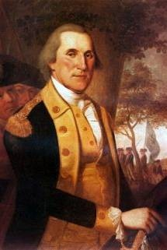
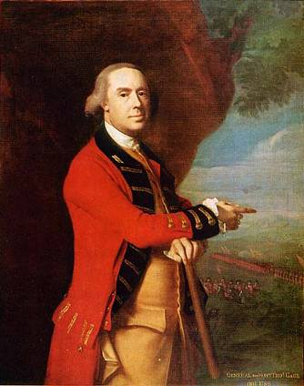
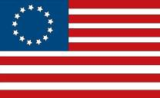
Differing Military Strategies
General Washington
The Americans
The British
General Gage
Outlast the British
Defend colonial lands & drag out the war
Guerilla tactics
Make an alliance with France
Divide & Conquer
Use Loyalists, seize property, encourage slave revolts
Split the Northern & Southern colonies
Blockade ports to prevent trade
As long as Britain did not defeat the Continental Army, England could not win

Slide 9
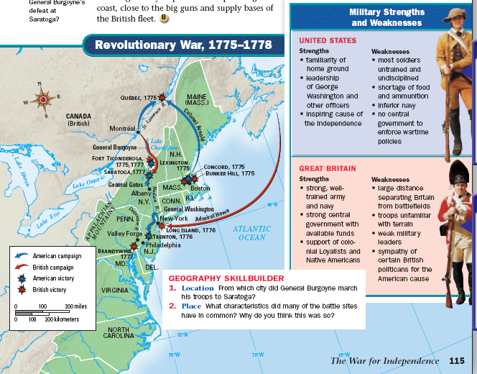
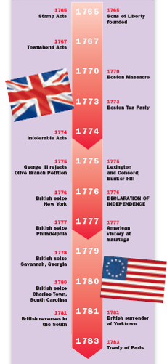
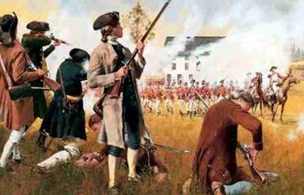
The American Revolution began at Lexington & Concord

Slide 10
British victories from 1776-1777 made an American victory look impossible

Slide 11
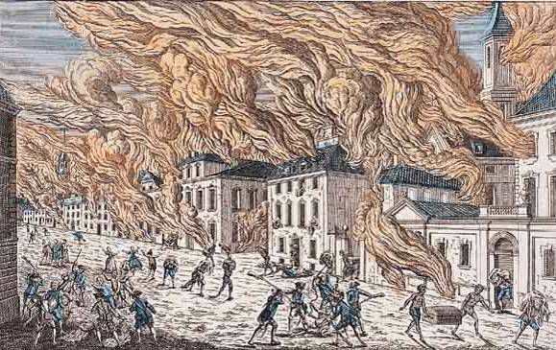
British Seizure & Burning of New York, 1776

Slide 12
On Christmas Eve 1776, Washington gave Americans hope by crossing the Delaware River & surprising British troops in Trenton, NJ

Slide 13
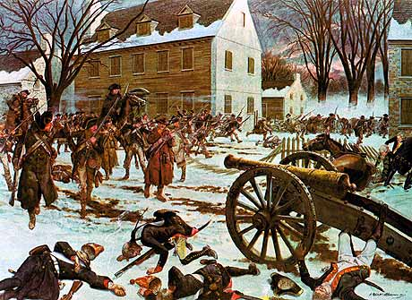
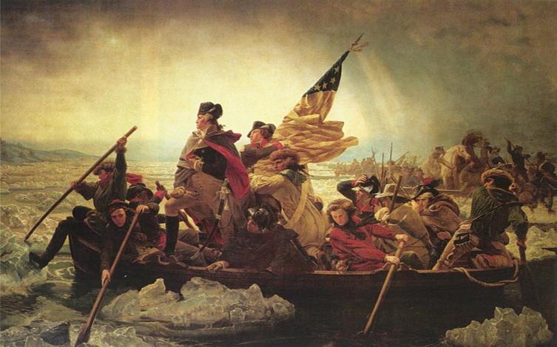
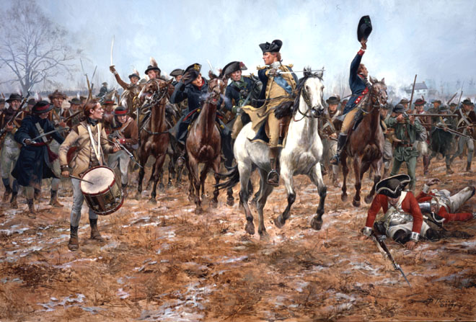
Crossing the Delaware in route to a surprise attack at Trenton & Princeton, 1776

Slide 14
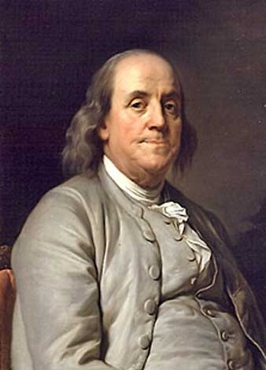
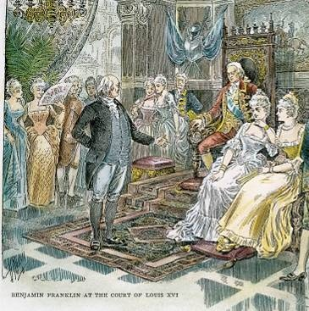
From the beginning of the war, American diplomats, led by Benjamin Franklin, tried to form an alliance with the French
The French gov’t was willing, but needed to see that the Americans had a chance to win
The French agreed to join the American cause after the battle of Saratoga in 1777

Slide 15
The Battle of Saratoga was a turning point because France joined the Americans as an ally

Slide 16
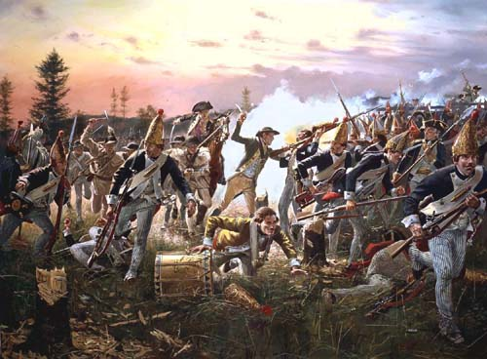
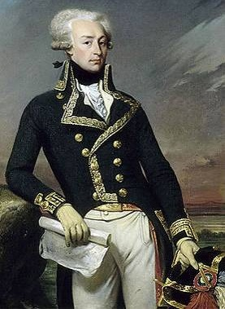
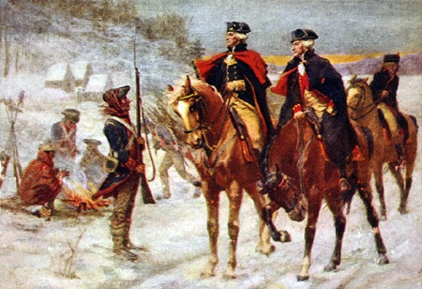
The “turning point” of the Revolution: The Battle of Saratoga, 1777
After Saratoga, French general Lafayette helped train American troops while the French navy helped neutralize the British advantage on the high seas
When French troops arrived in the spring 1778, the tide of the war shifted in favor of the Americans
Marquis de Lafayette

Slide 17
During the winter of 1777-78, Continental Army troops nearly starved at Valley Forge, PA but Washington & Lafayette inspired & trained the troops to continue the fight
Notes:
http://www.history.com/shows/america-the-story-of-us/videos/declaration-of-independence#george-washington
Washington: the story of us video (2.19)

Slide 18
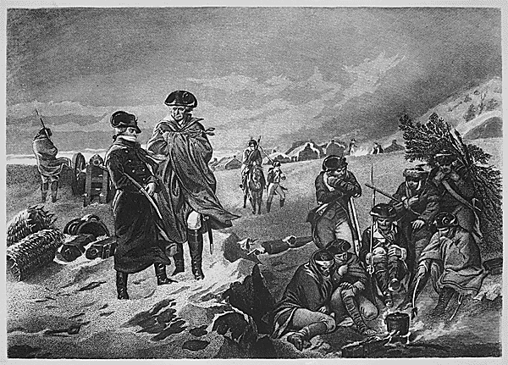
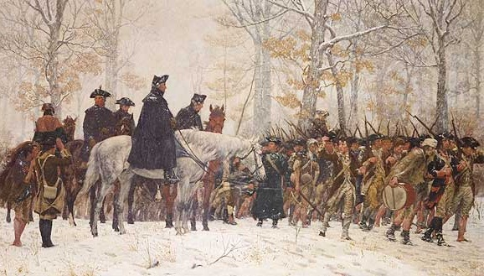
Near Starvation at Valley Forge, PA in 1778

Slide 19
From 1778-1781, both sides traded victories, but the war finally came to a conclusion at the Battle of Yorktown

Slide 20
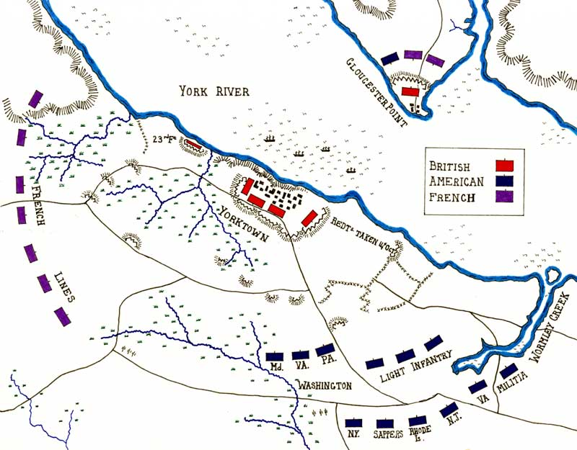
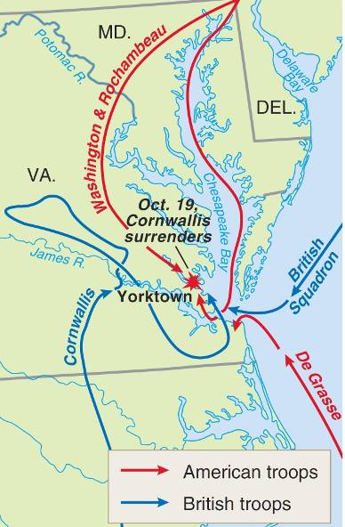
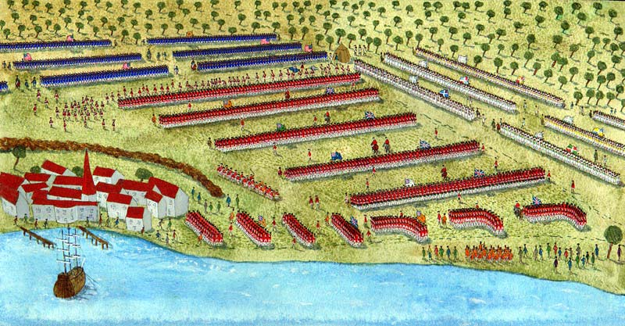
The Battle of Yorktown Video
By 1781, Washington trapped the army of British General Cornwallis between the Continental Army & the French navy
Notes:
http://www.history.com/shows/america-the-story-of-us/videos/declaration-of-independence#yorktown
America the Story of Us video on Yorktown (3.00)

Slide 21
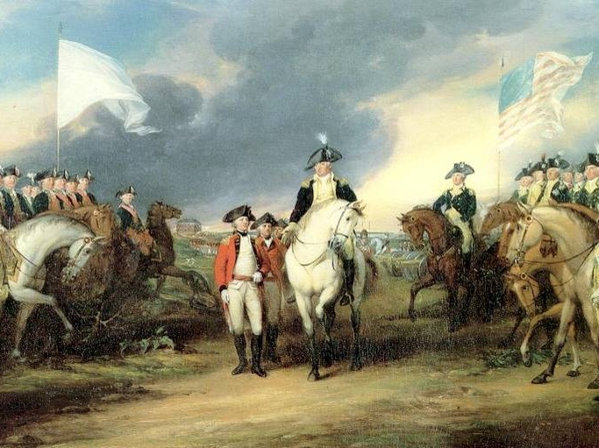
The Battle of Yorktown
General Cornwallis surrendered to Washington in 1781, ending the American Revolution
Cornwallis’ surrender was the “day the world turned upside down”
Notes:
Why the Americans won the Revolutionary War: America Story of Us video (3.20)

Slide 22
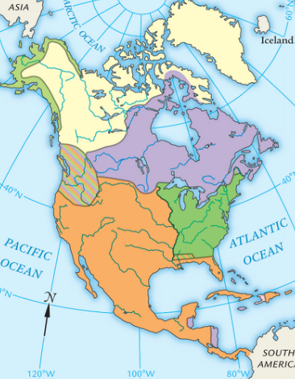
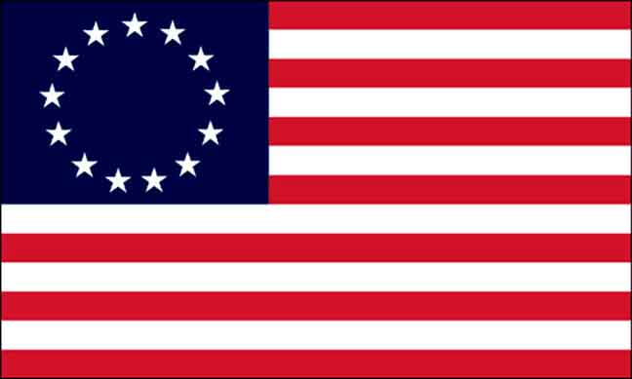
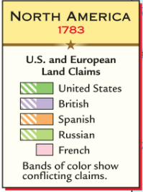
The Treaty of Paris in 1783 ended the American Revolution
The treaty gave America:
Full independence
All territory east of Mississippi River, between Canada & Florida
The removal of the British army from U.S. claims in America

Slide 23
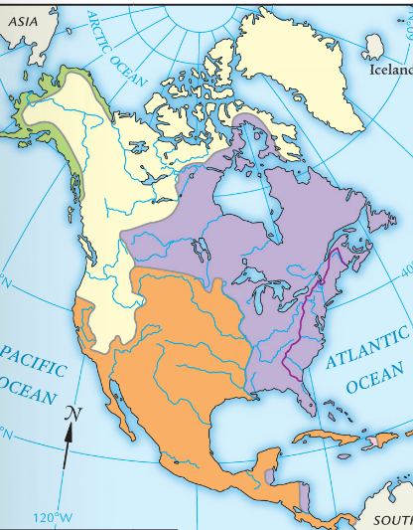
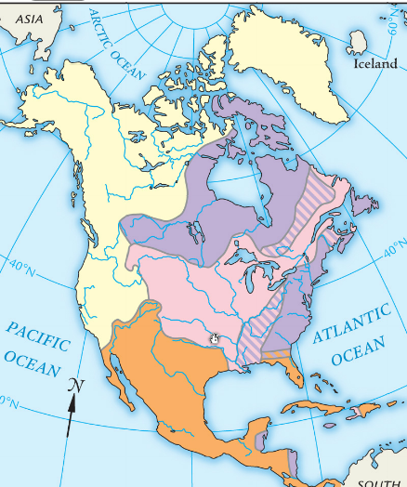
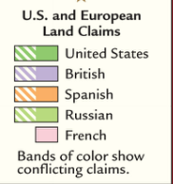
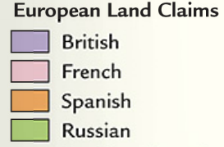
North America 1763
North America 1783
North America 1754

